Slide 1
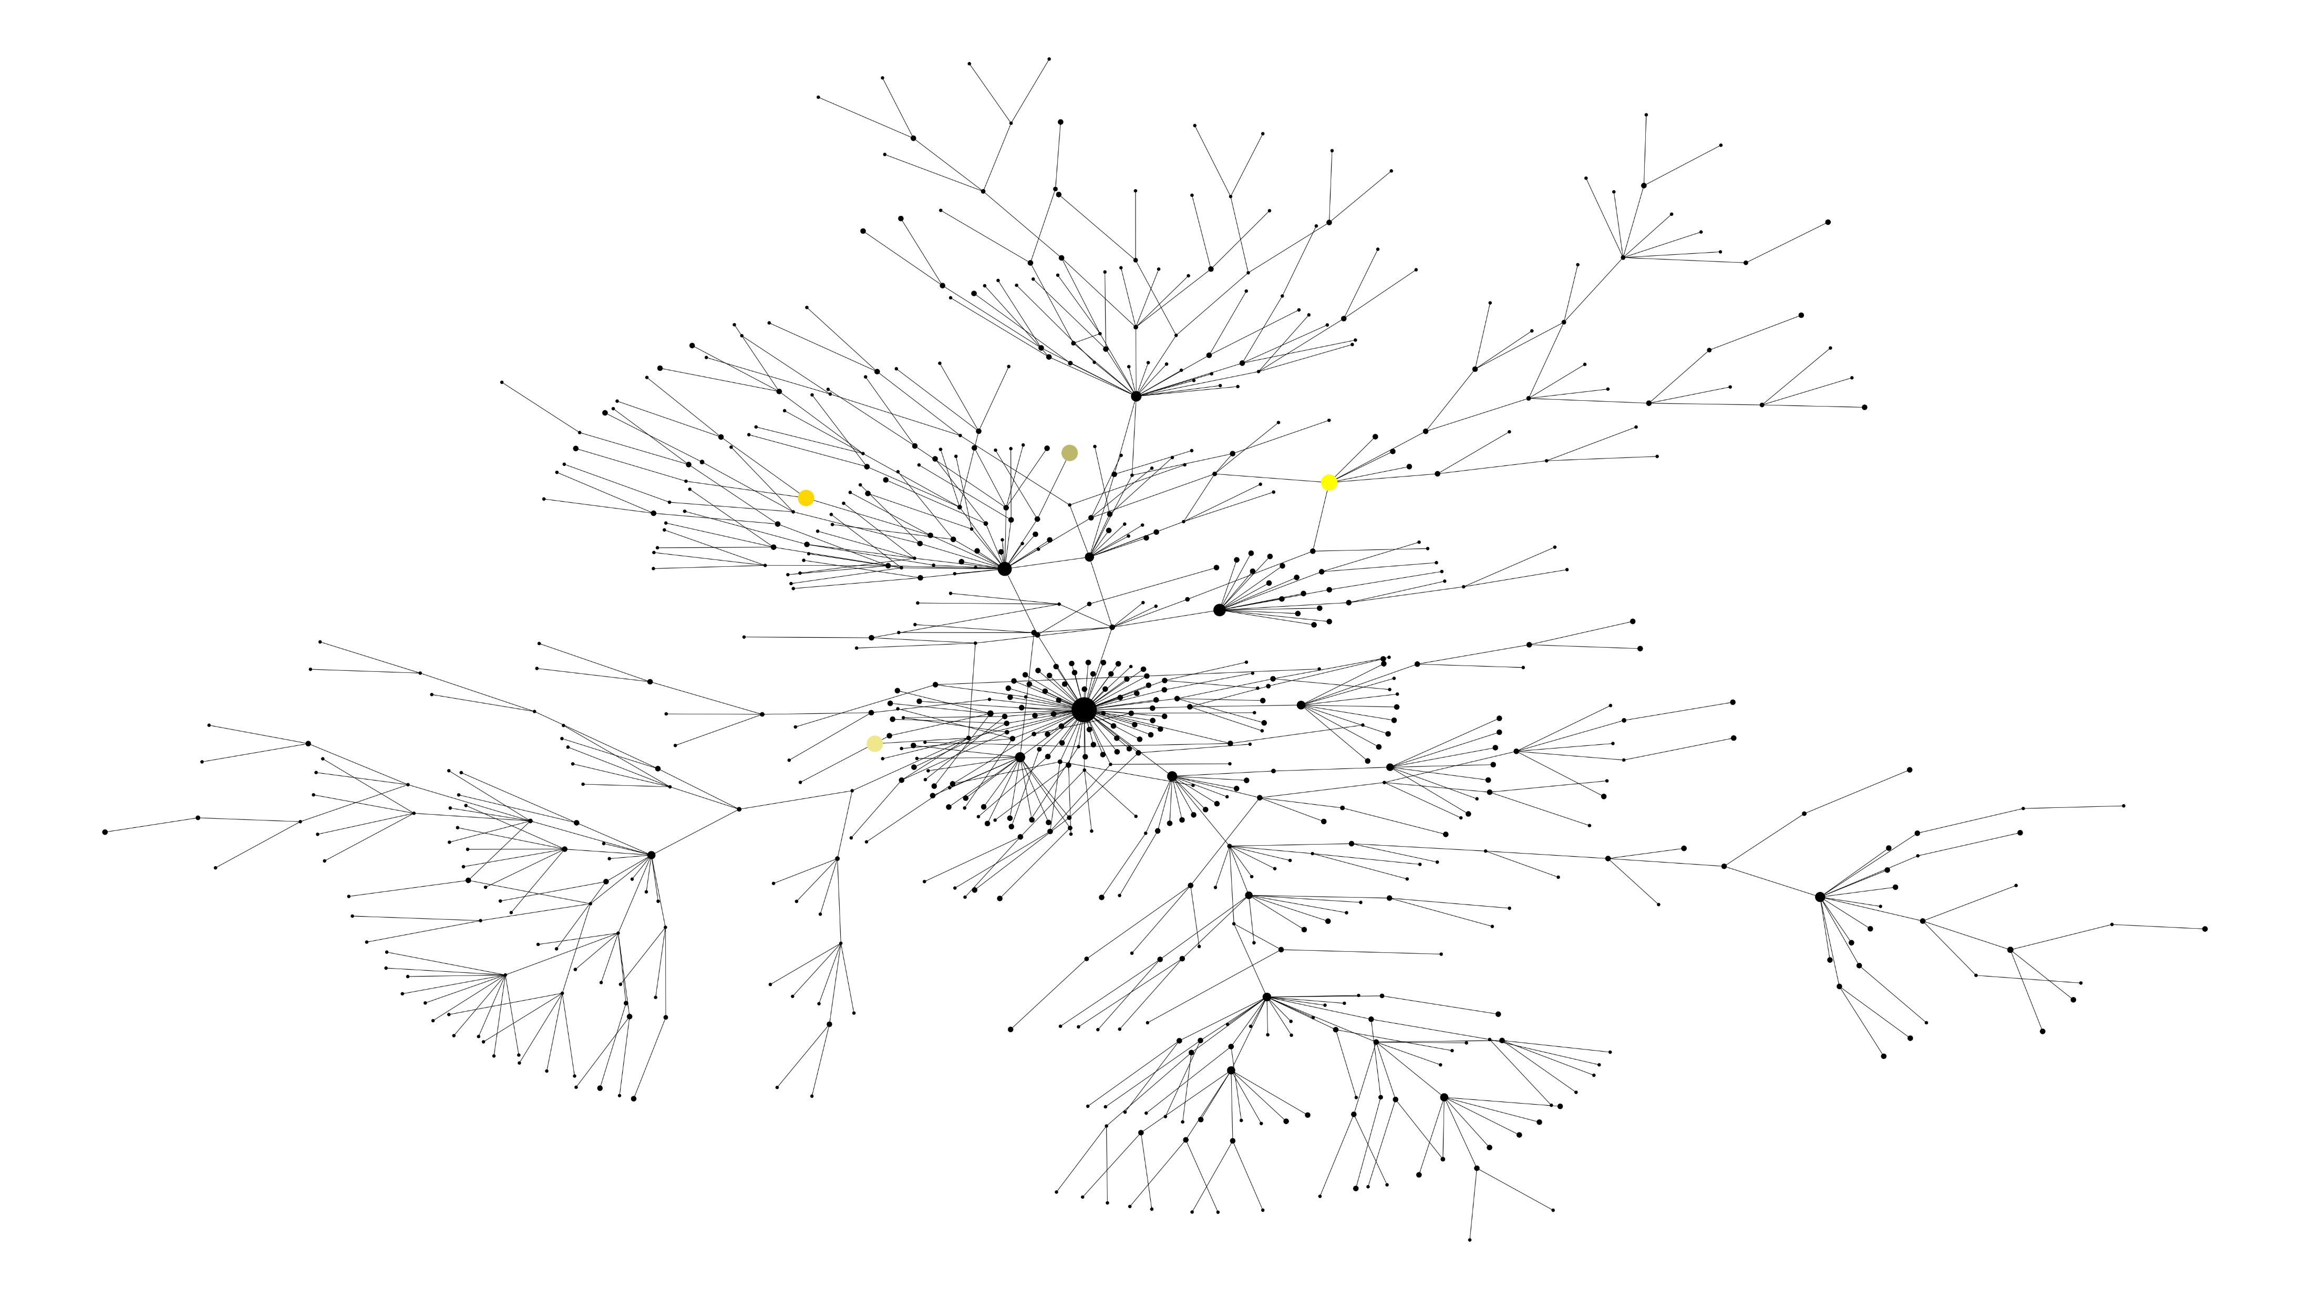
References
Reference UK Reference South Africa Ref Brazil Reference

Slide 2
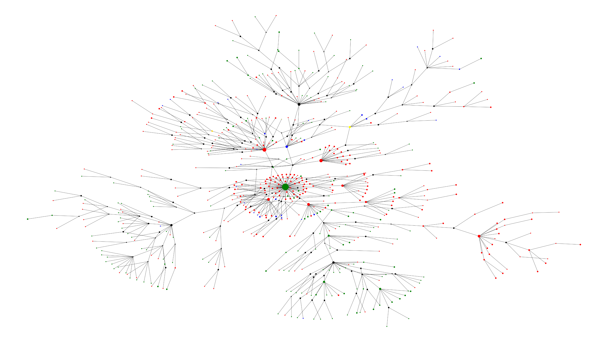
Symptom Graph
Symptomatic Asymptomatic Unknown Reference UK Reference South Africa Ref Brazil Reference

Slide 3
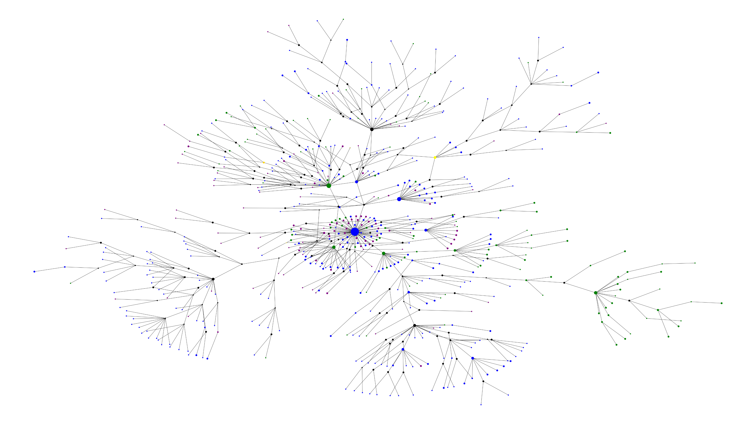
Outcome Graph
Alive Deceased Unknown Reference UK Reference South Africa Ref Brazil Reference

Slide 4
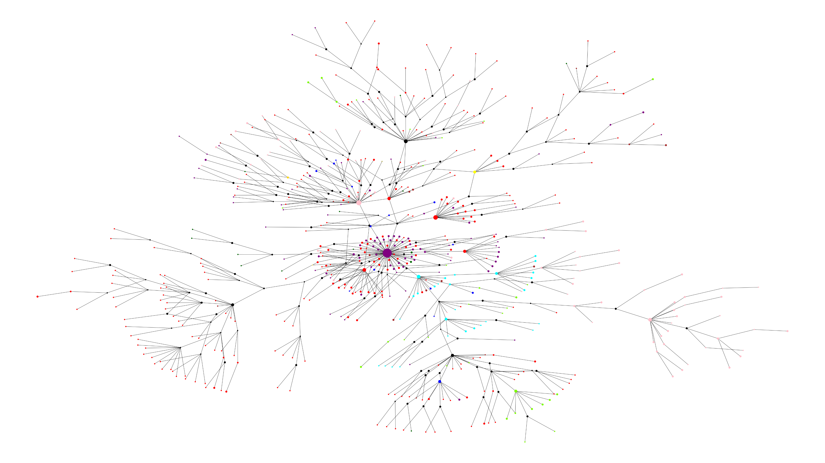
Location Graph
California Montana New York Puerto Rico South Carolina Louisiana Texas Other Reference UK Reference South Africa Ref Brazil Reference

Slide 5
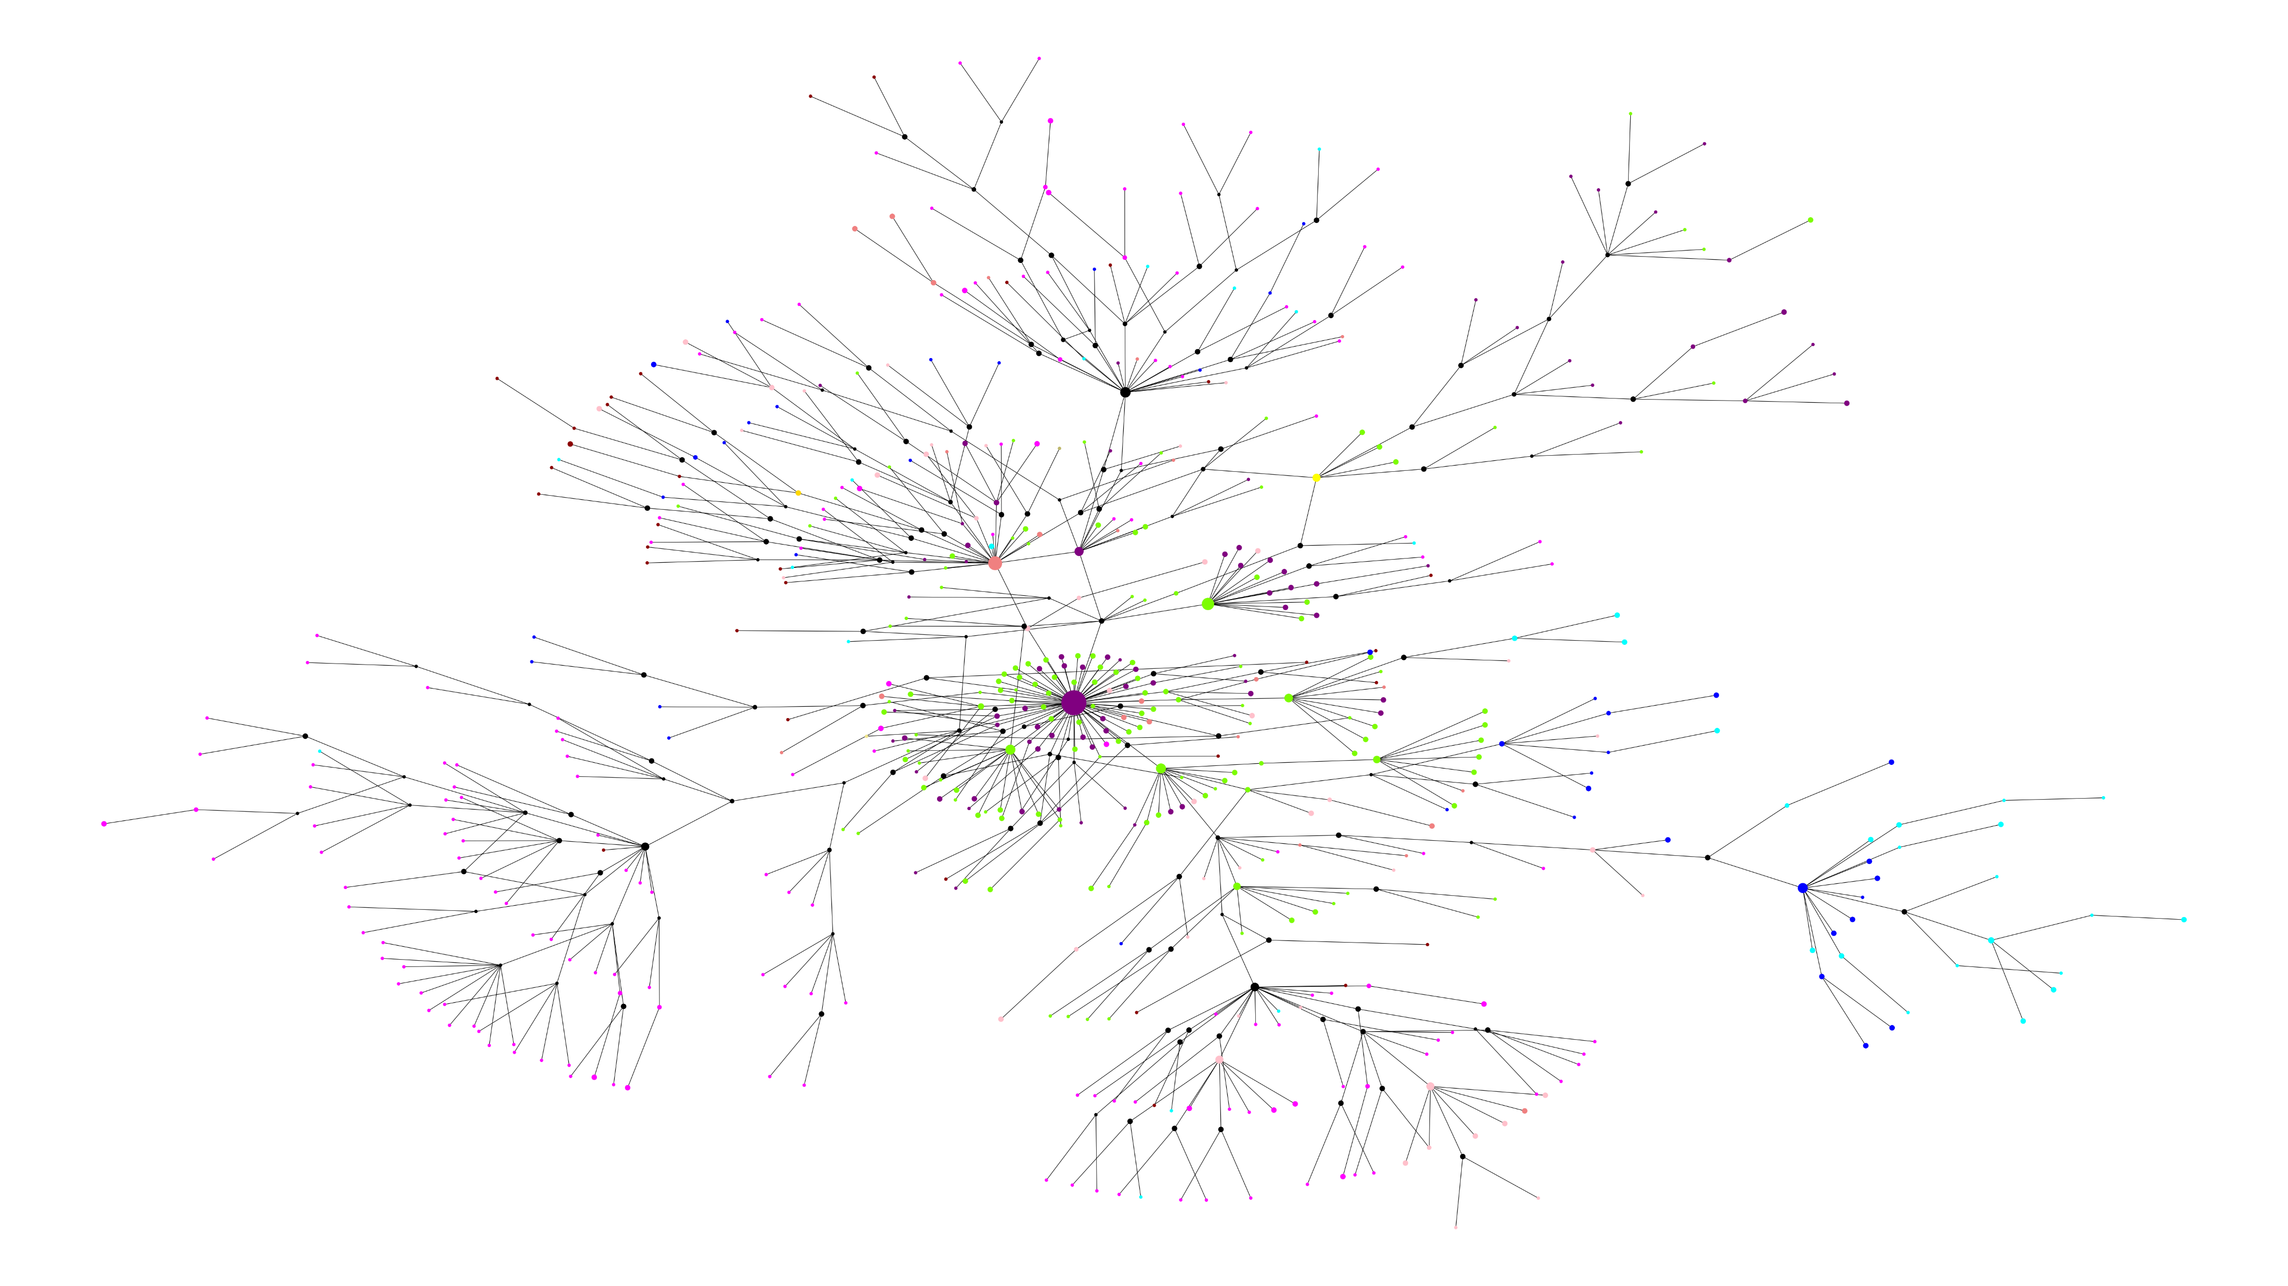
Dates Graph
February / March 2020 April 2020 May / June 2020 July 2020 August / September 2020 October / November 2020 December 2020 January / February 2021 Reference UK Reference South Africa Ref Brazil Reference

Slide 6
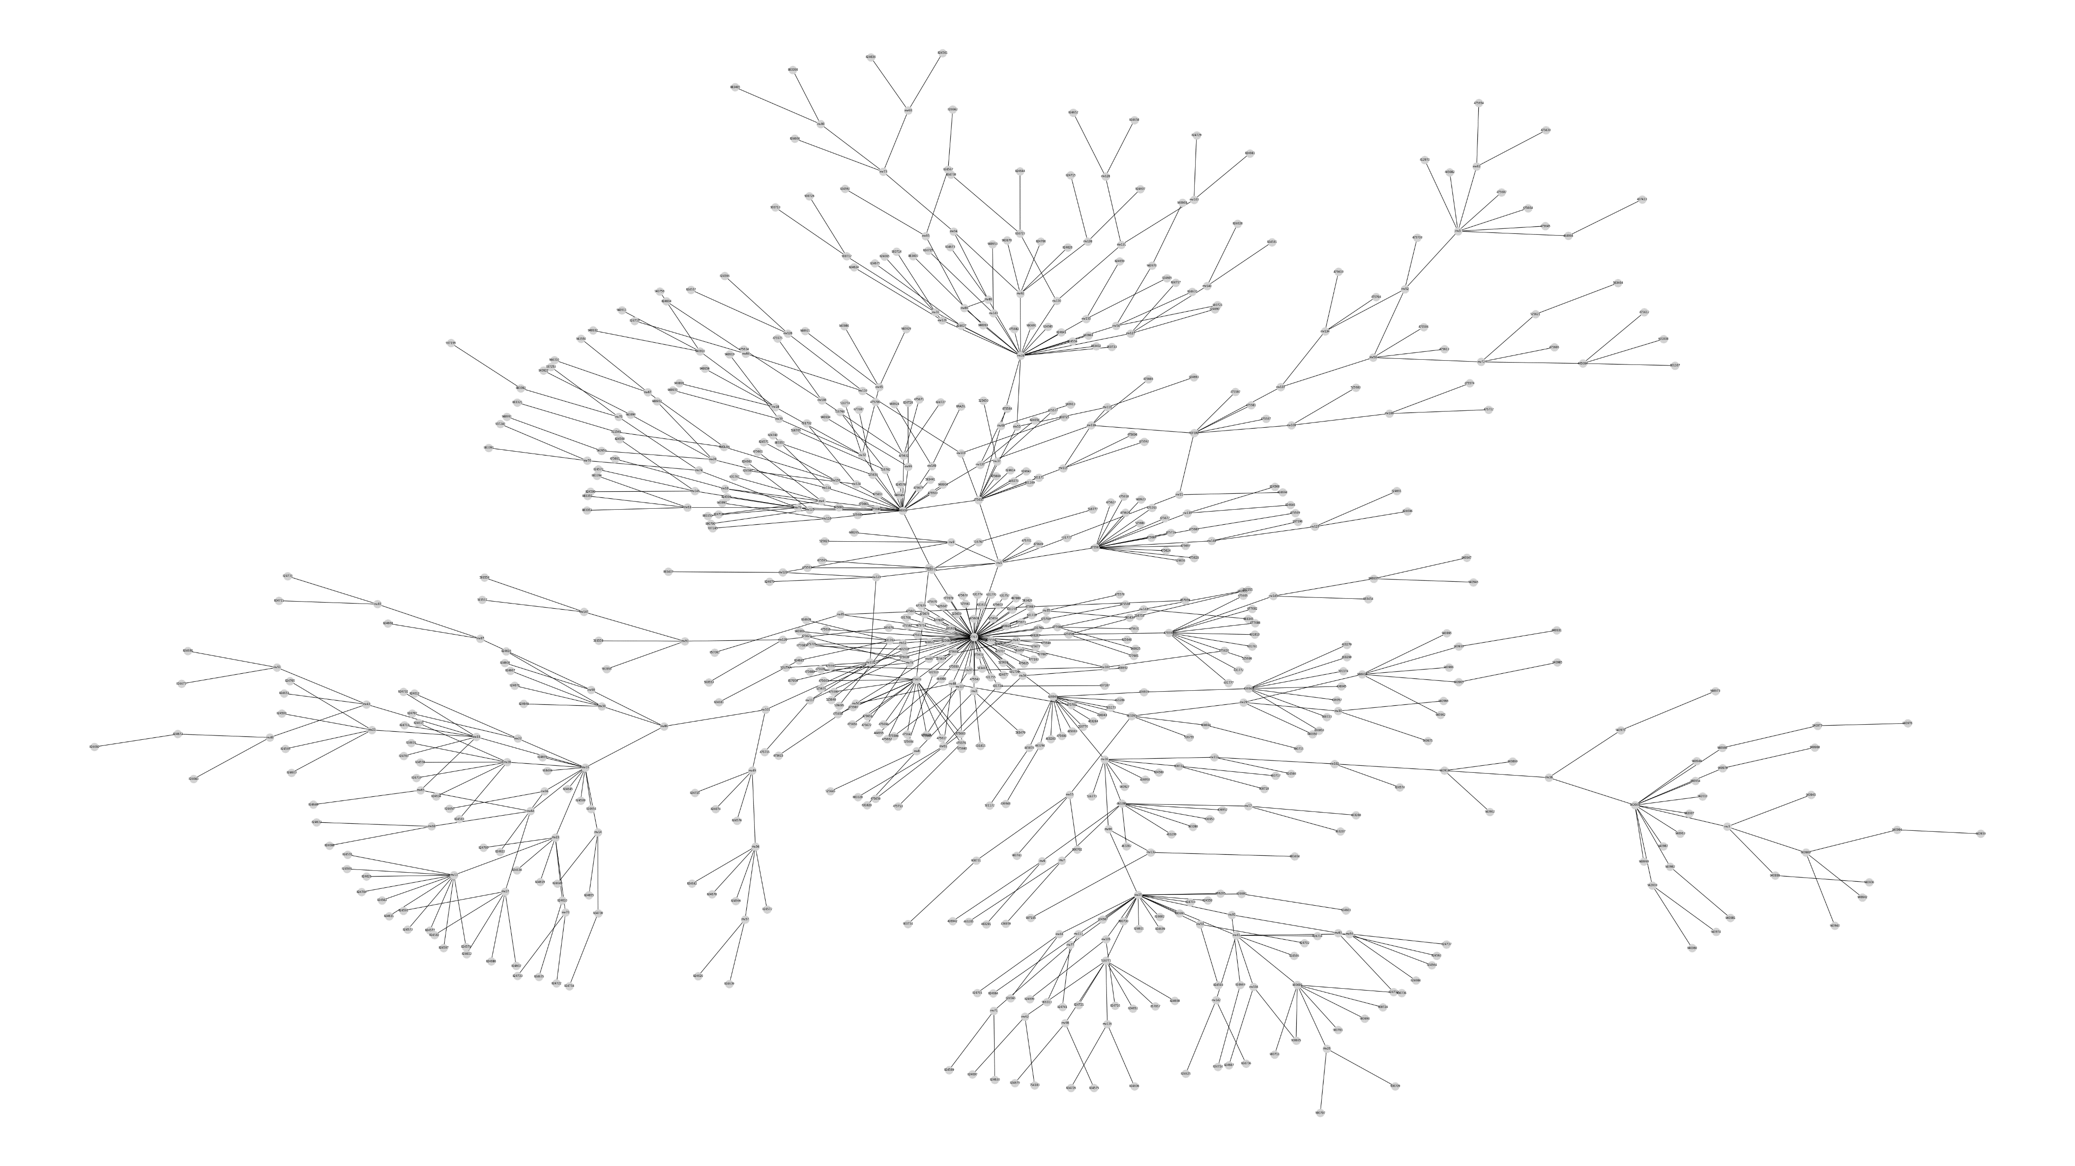
Names graph

Slide 7
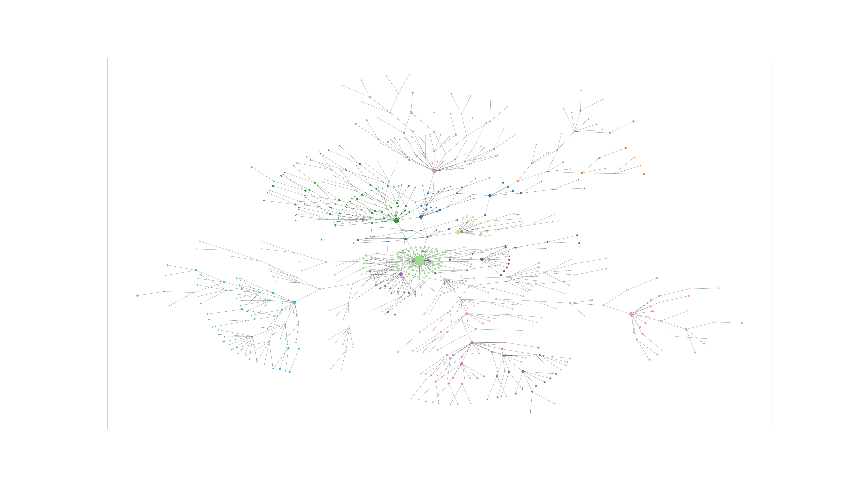
Community detection – Louvain 15 Clusters

Slide 8
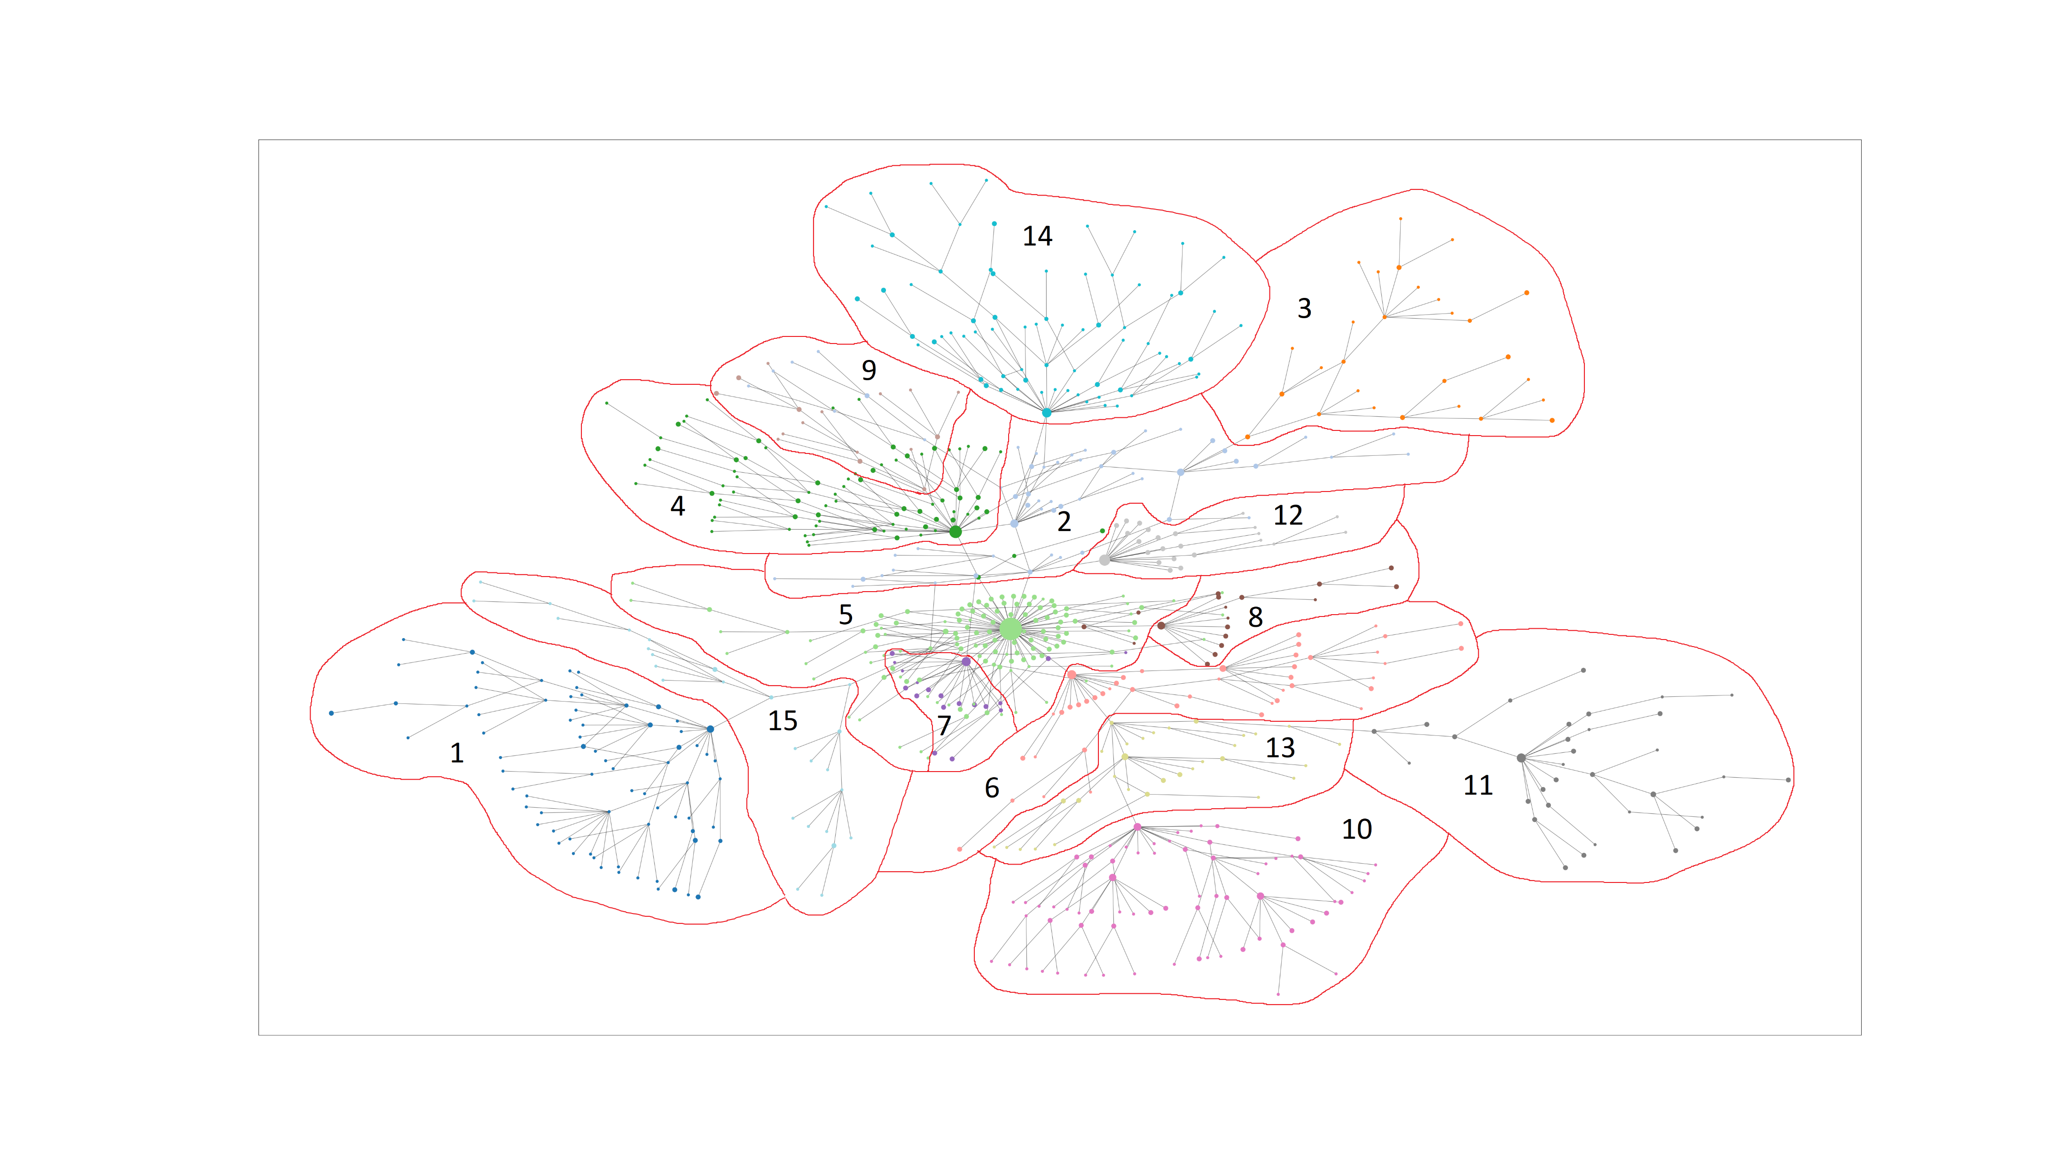
Community detection – Louvain 15 Clusters

Slide 9
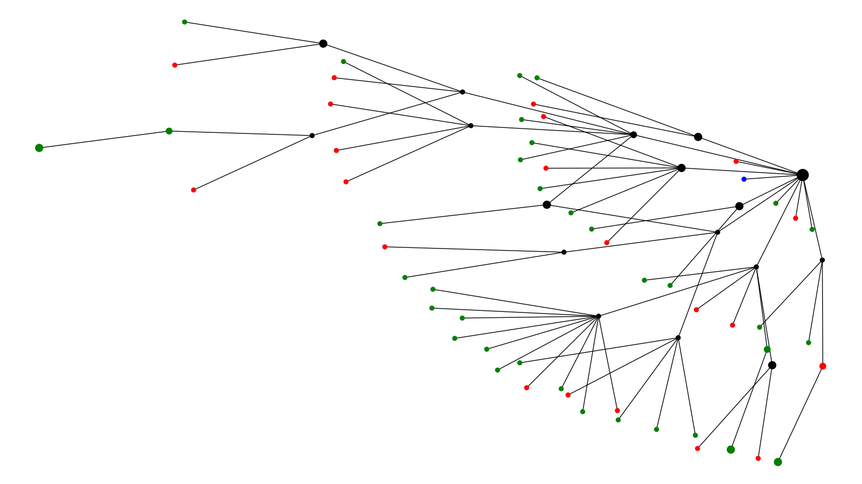
Symptom Cluster 1
Symptomatic Asymptomatic Unknown

Slide 10
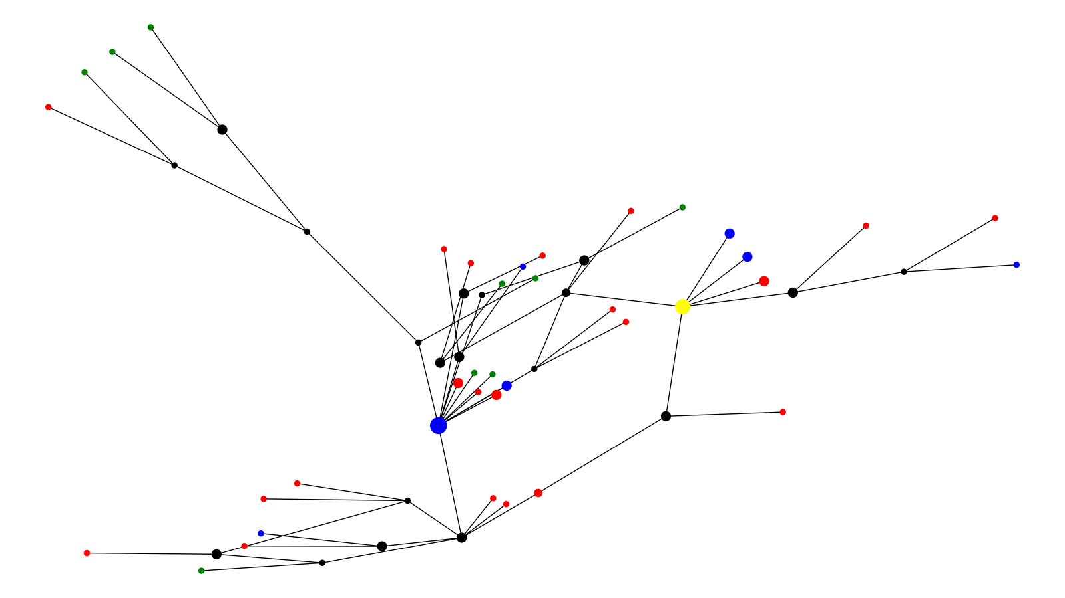
Symptom Cluster 2
Symptomatic Asymptomatic Unknown Reference

Slide 11
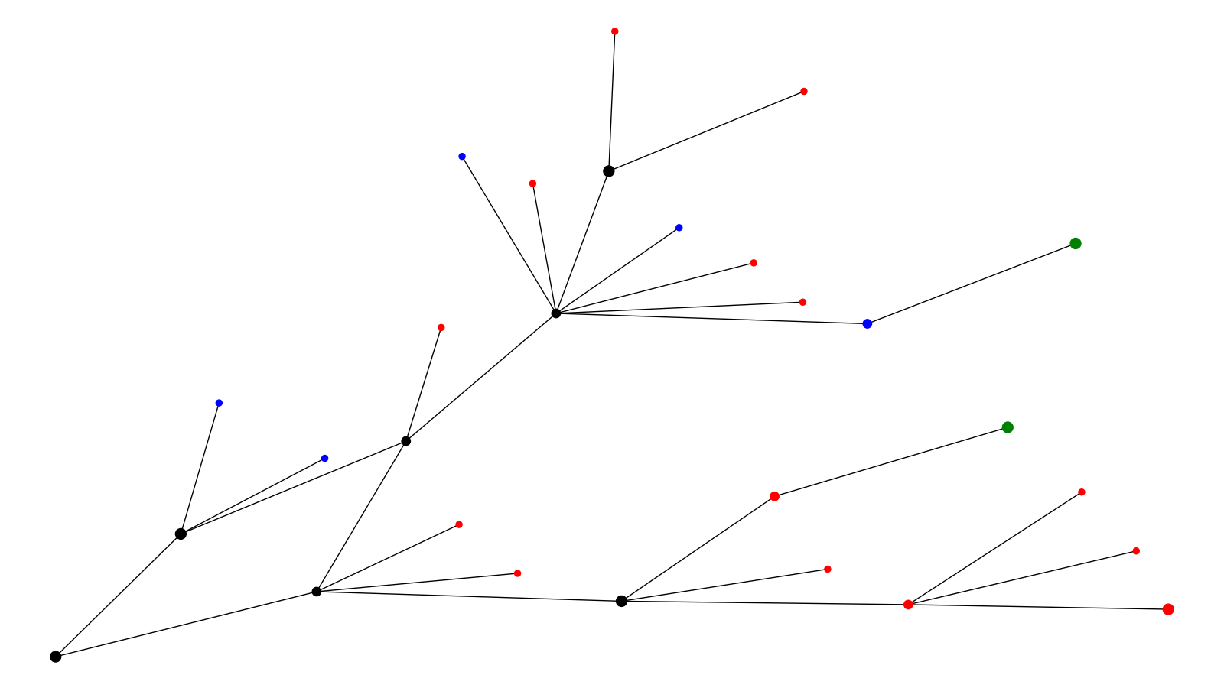
Symptom Cluster 3
Symptomatic Asymptomatic Unknown

Slide 12
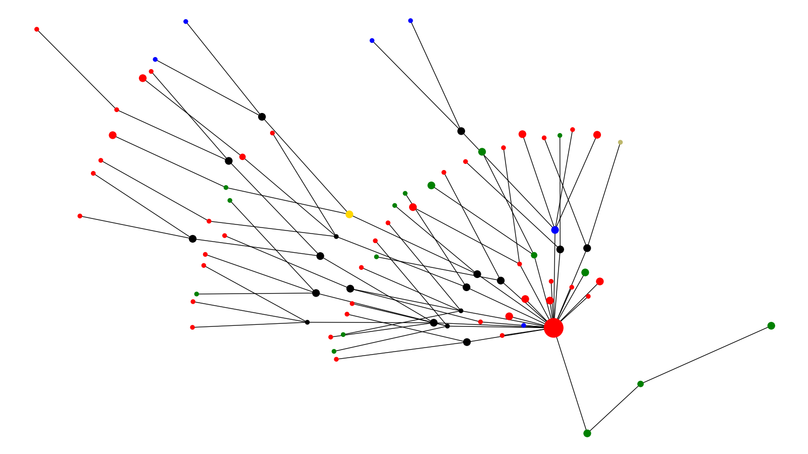
Symptom Cluster 4
Symptomatic Asymptomatic Unknown UK Reference Brazil Reference

Slide 13
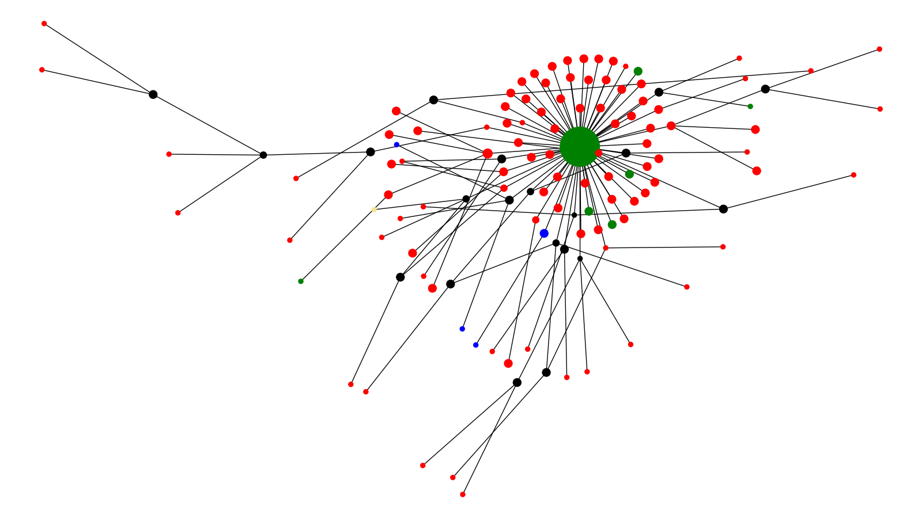
Symptom Cluster 5
Symptomatic Asymptomatic Unknown South Africa Ref

Slide 14
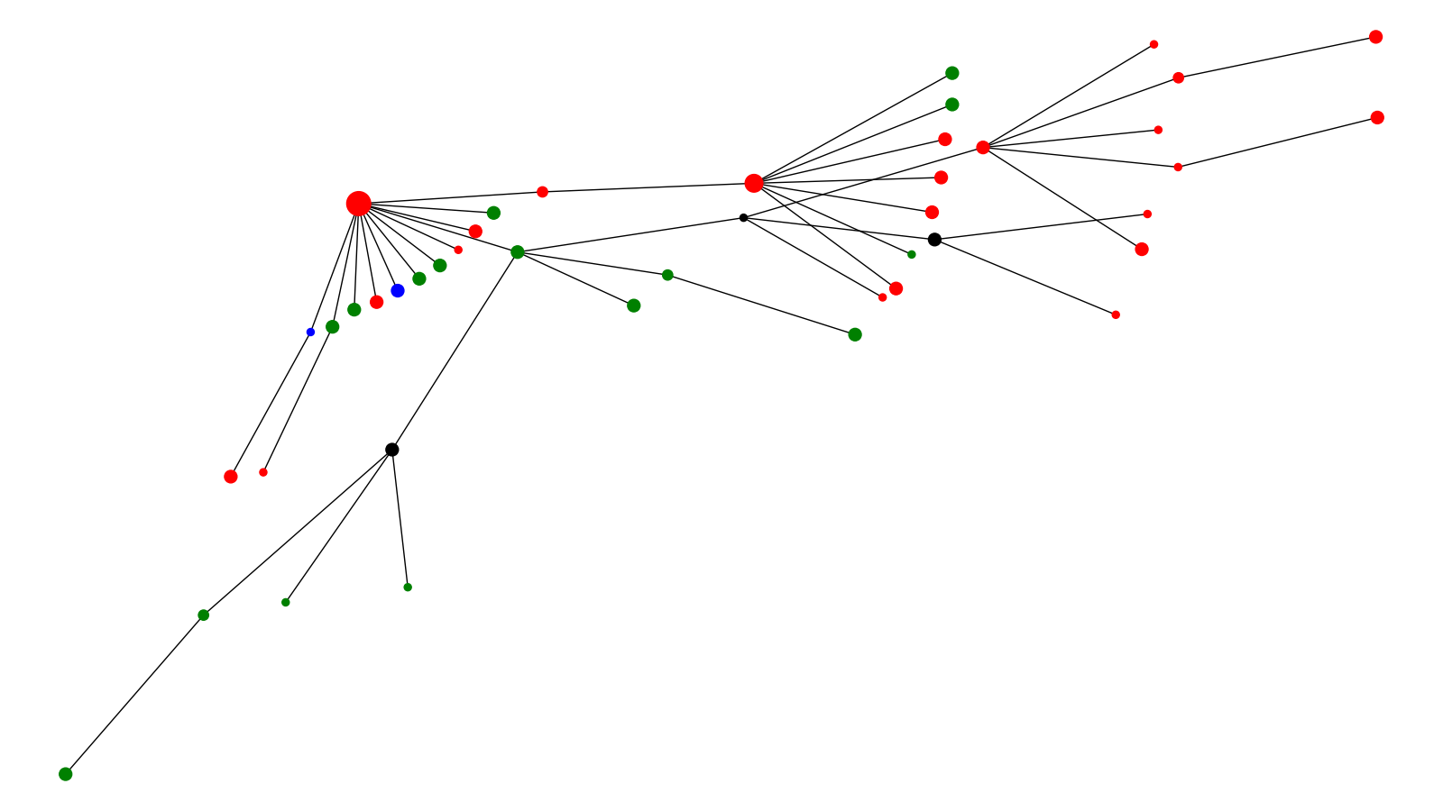
Symptom Cluster 6
Symptomatic Asymptomatic Unknown

Slide 15
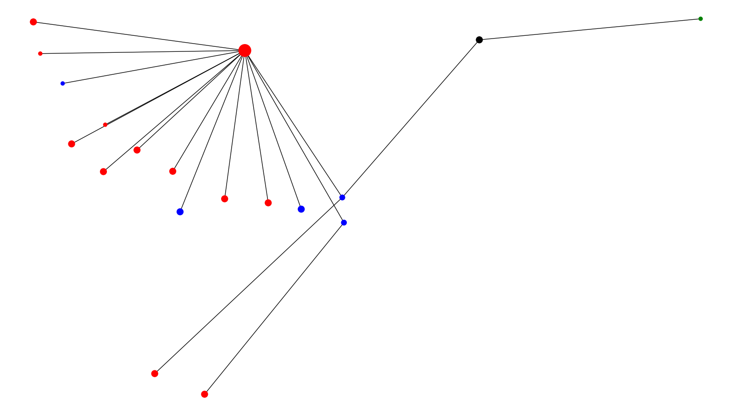
Symptom Cluster 7
Symptomatic Asymptomatic

Slide 16
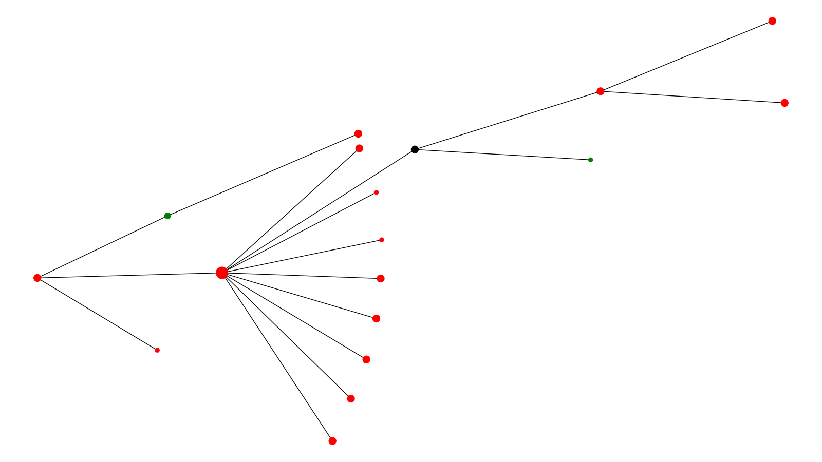
Symptom Cluster 8
Symptomatic Unknown

Slide 17
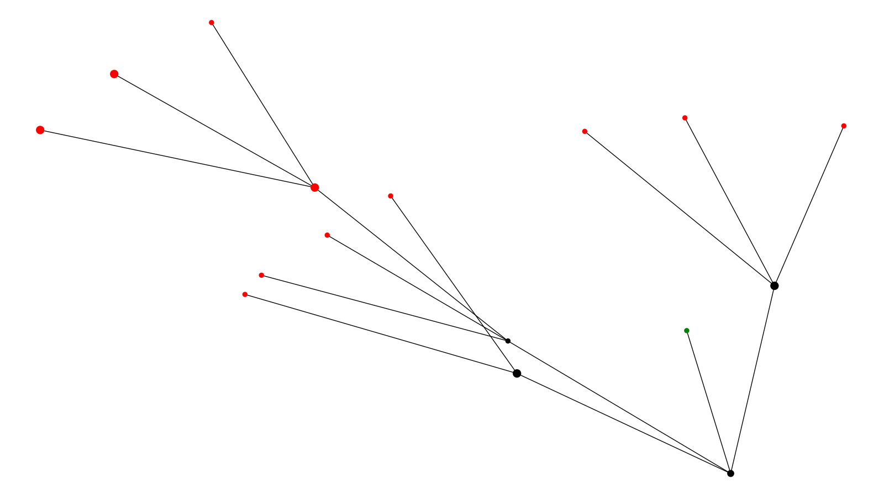
Symptom Cluster 9
Symptomatic Unknown

Slide 18
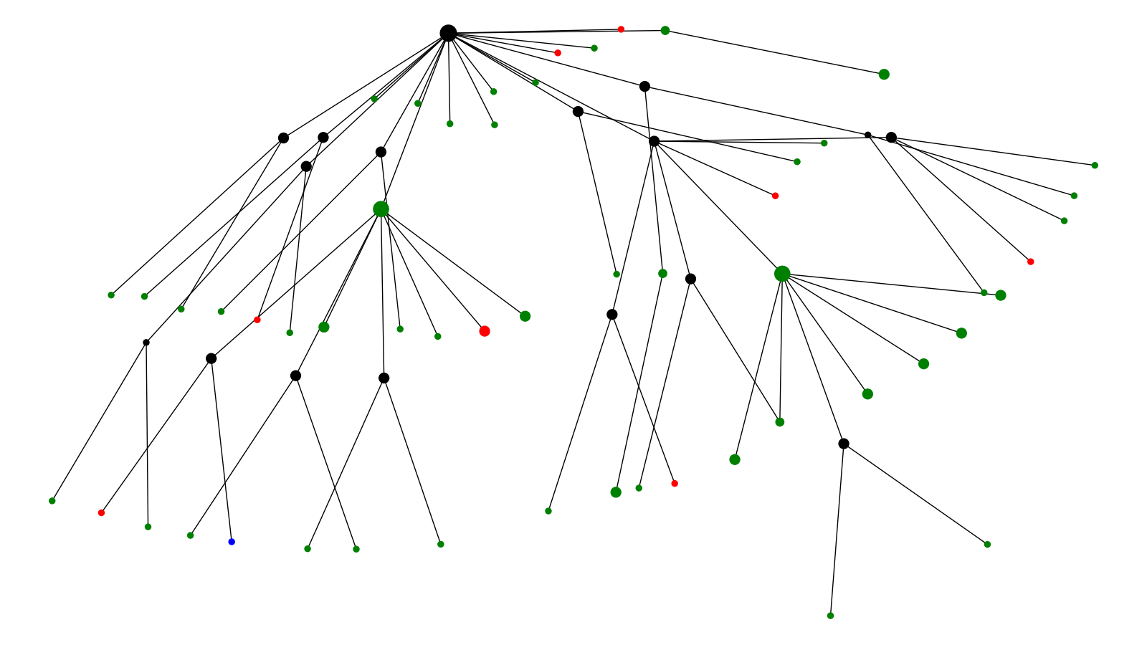
Symptom Cluster 10
Symptomatic Asymptomatic Unknown

Slide 19
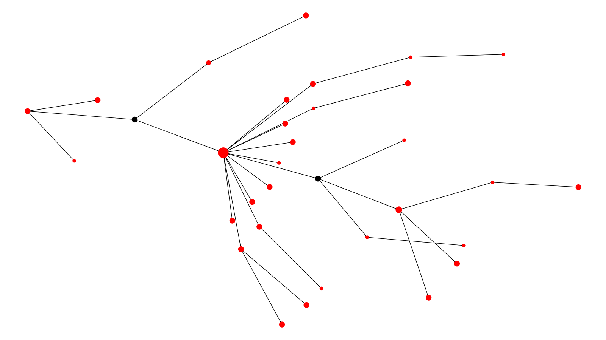
Symptom Cluster 11
Symptomatic

Slide 20
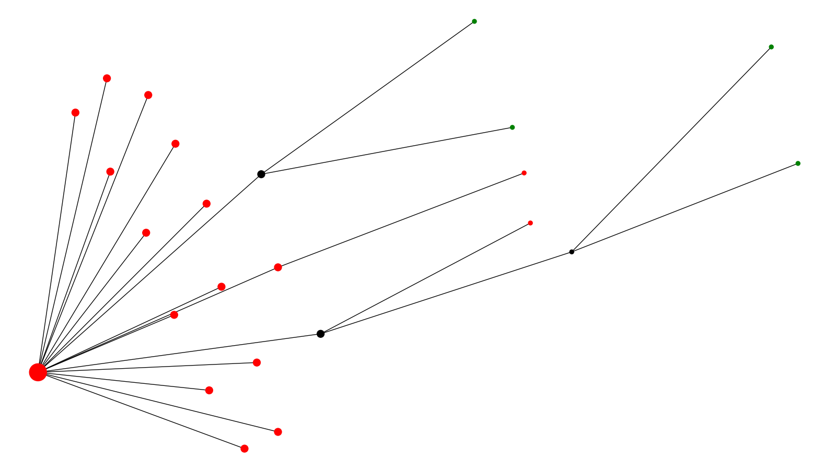
Symptom Cluster 12
Symptomatic Unknown

Slide 21
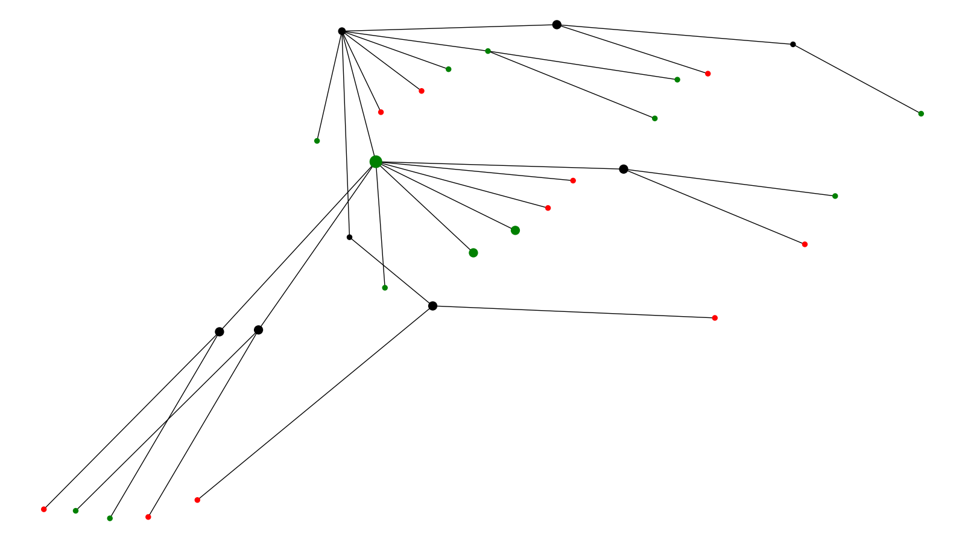
Symptom Cluster 13
Symptomatic Unknown

Slide 22
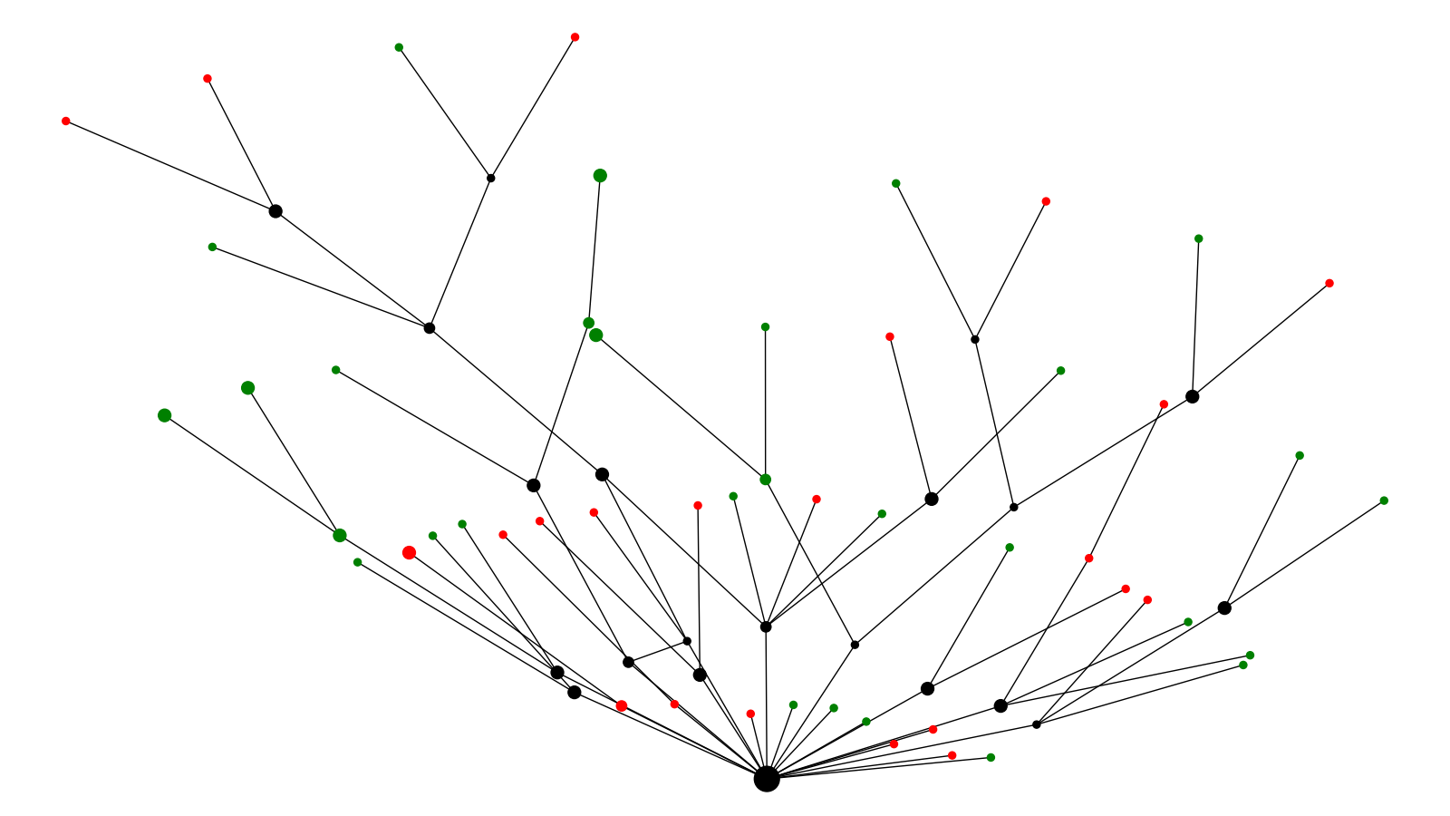
Symptom Cluster 14
Symptomatic Unknown

Slide 23
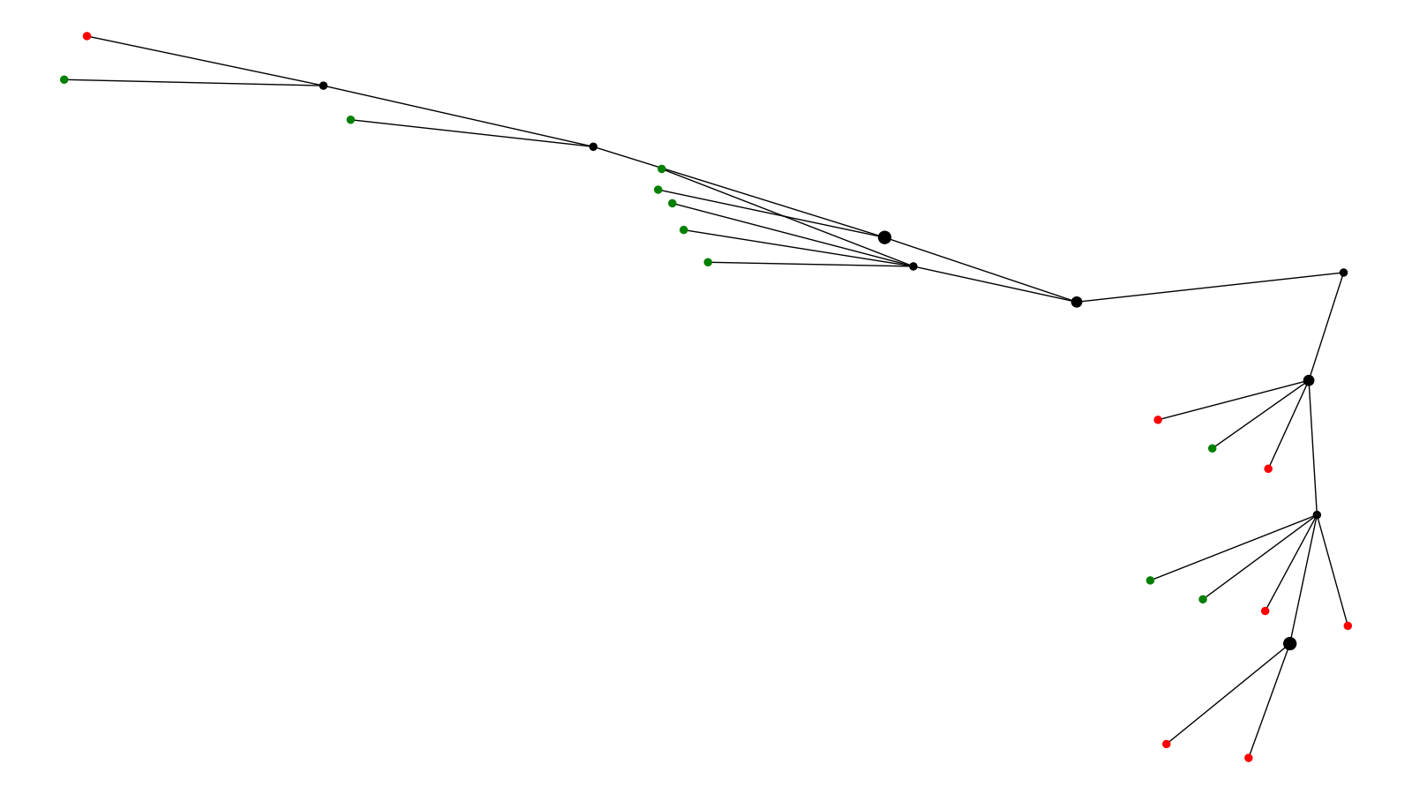
Symptom Cluster 15
Symptomatic Unknown

Slide 24
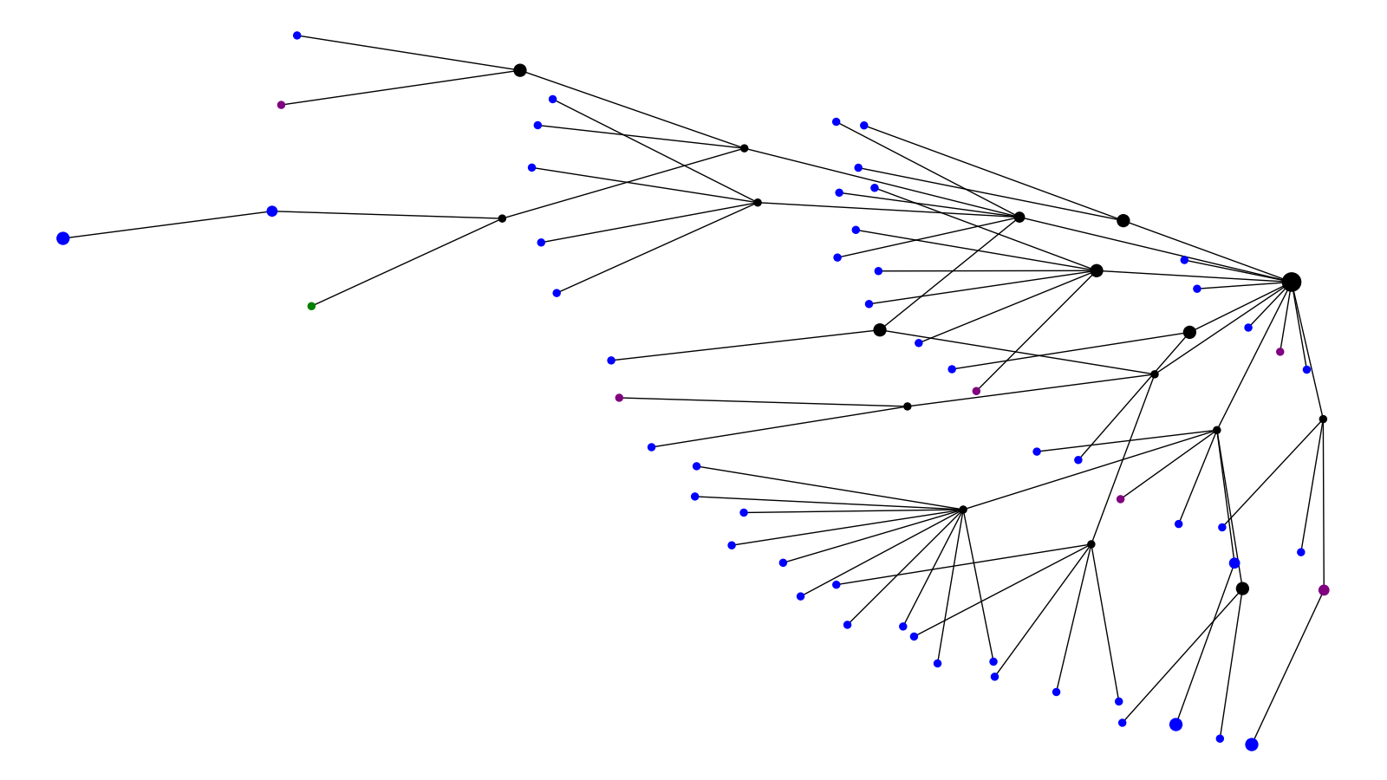
Outcome Cluster 1
Alive Deceased Unknown

Slide 25
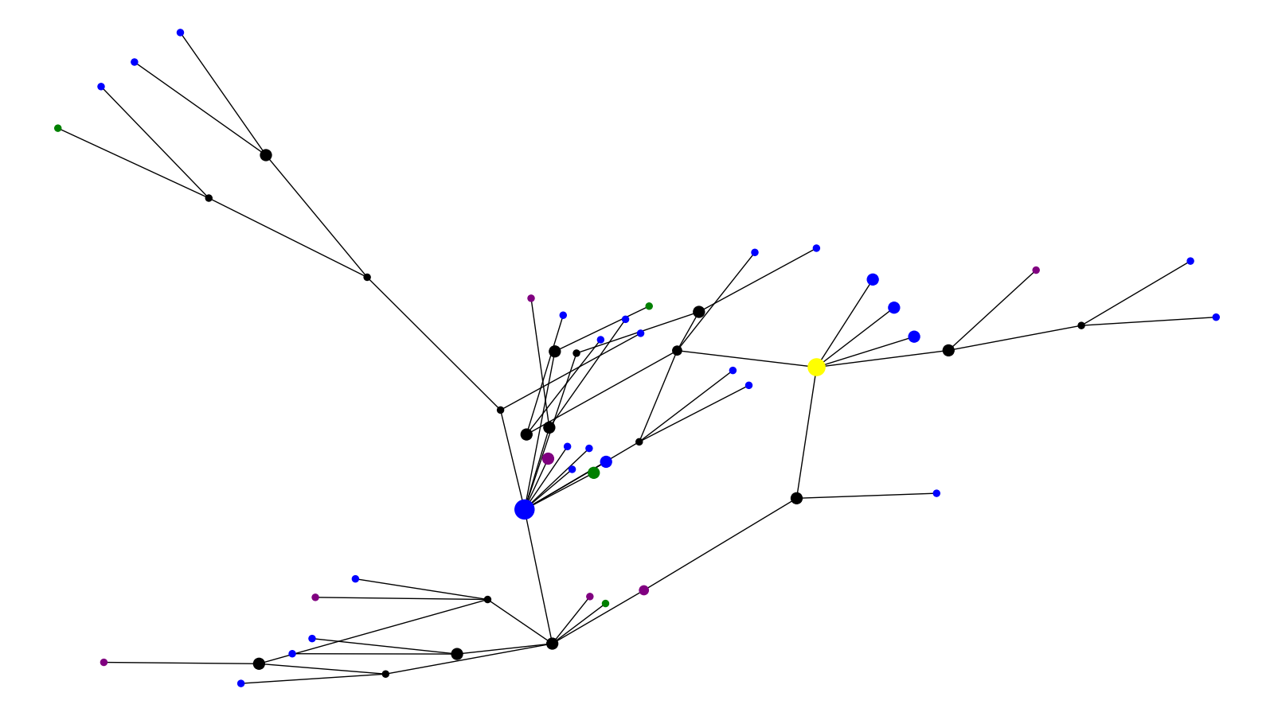
Outcome Cluster 2
Alive Deceased Unknown Reference

Slide 26
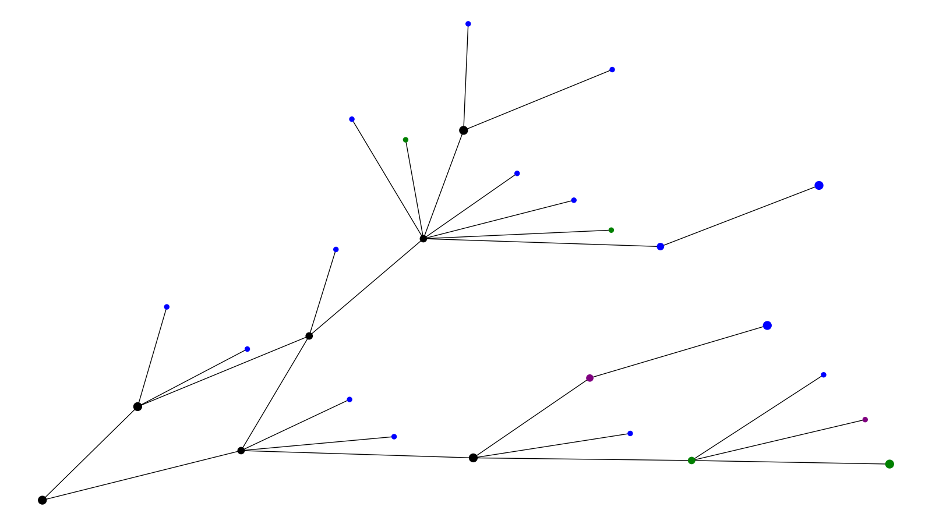
Outcome Cluster 3
Alive Deceased Unknown

Slide 27
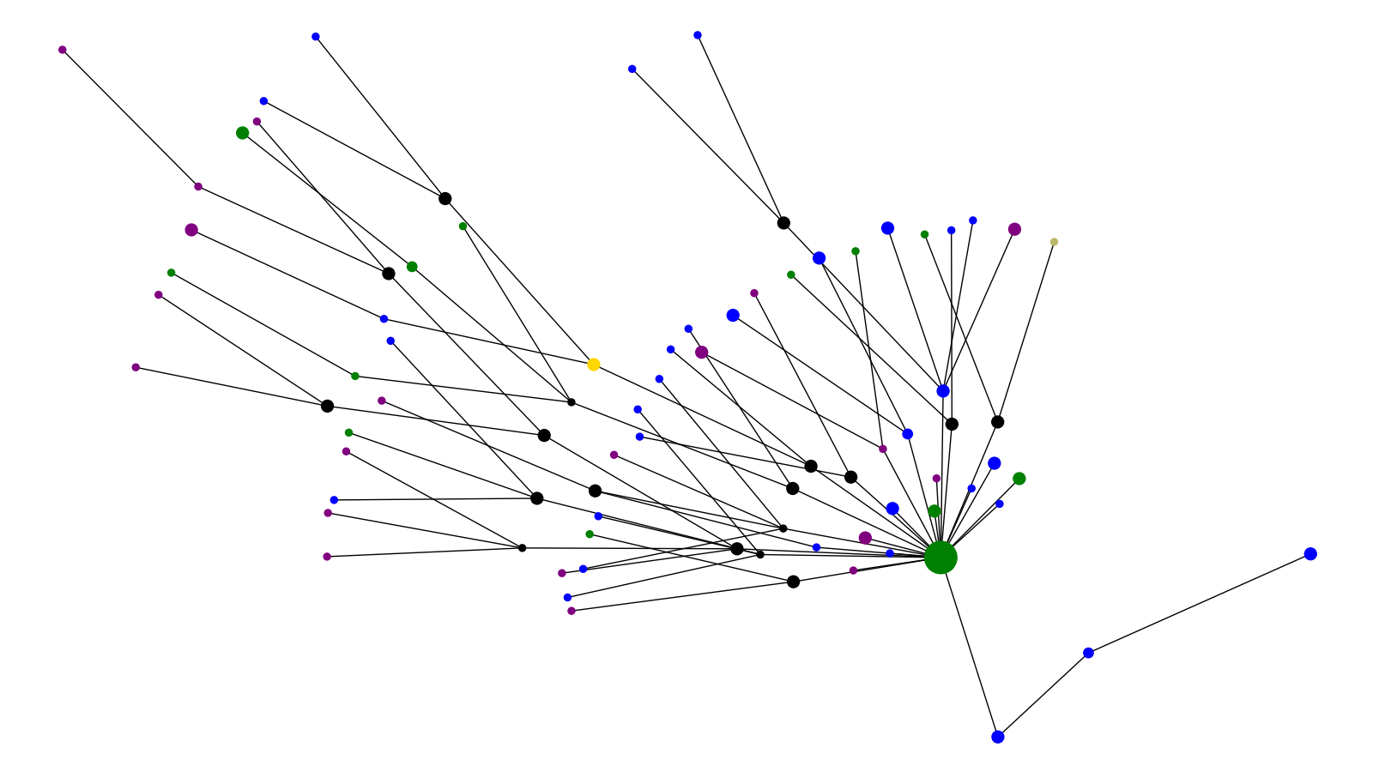
Outcome Cluster 4
Alive Deceased Unknown UK Reference Brazil Reference

Slide 28
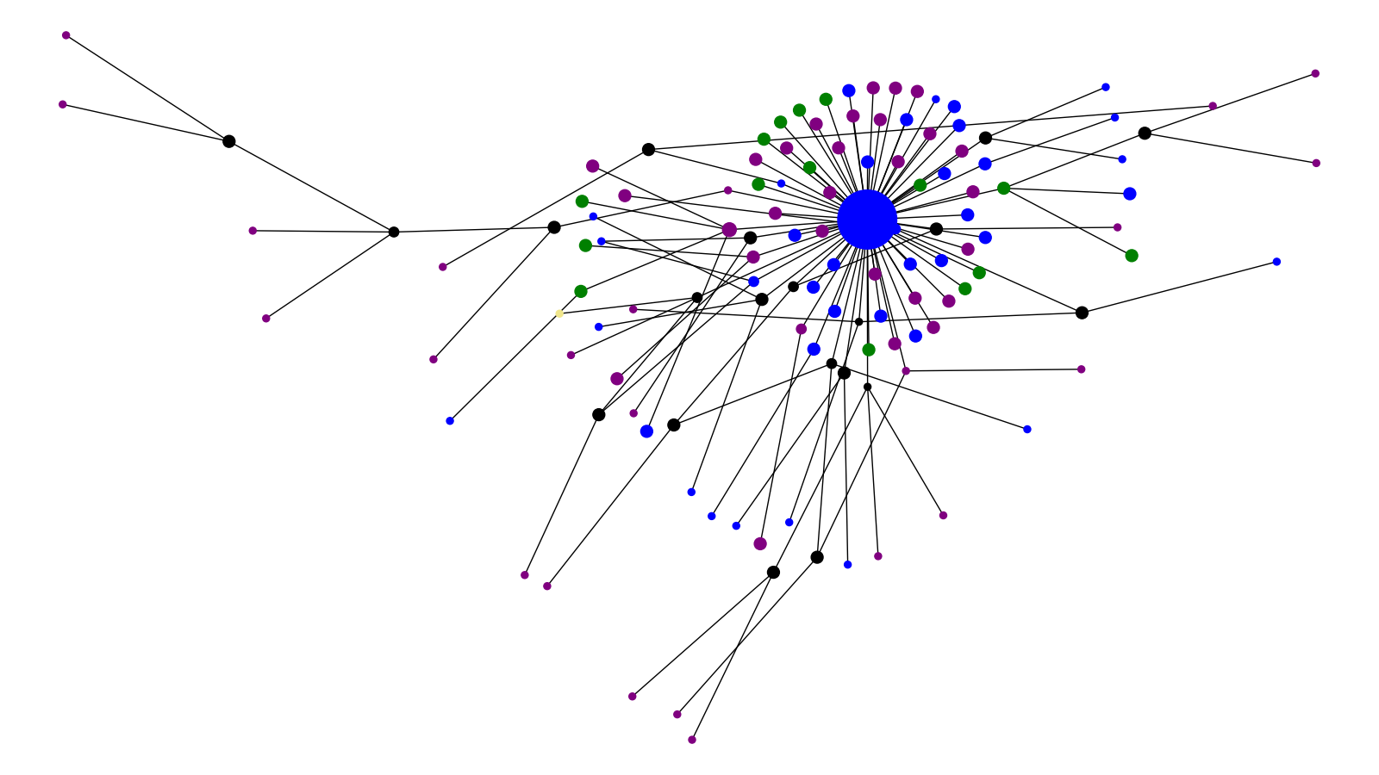
Outcome Cluster 5
Alive Deceased Unknown South Africa Ref

Slide 29
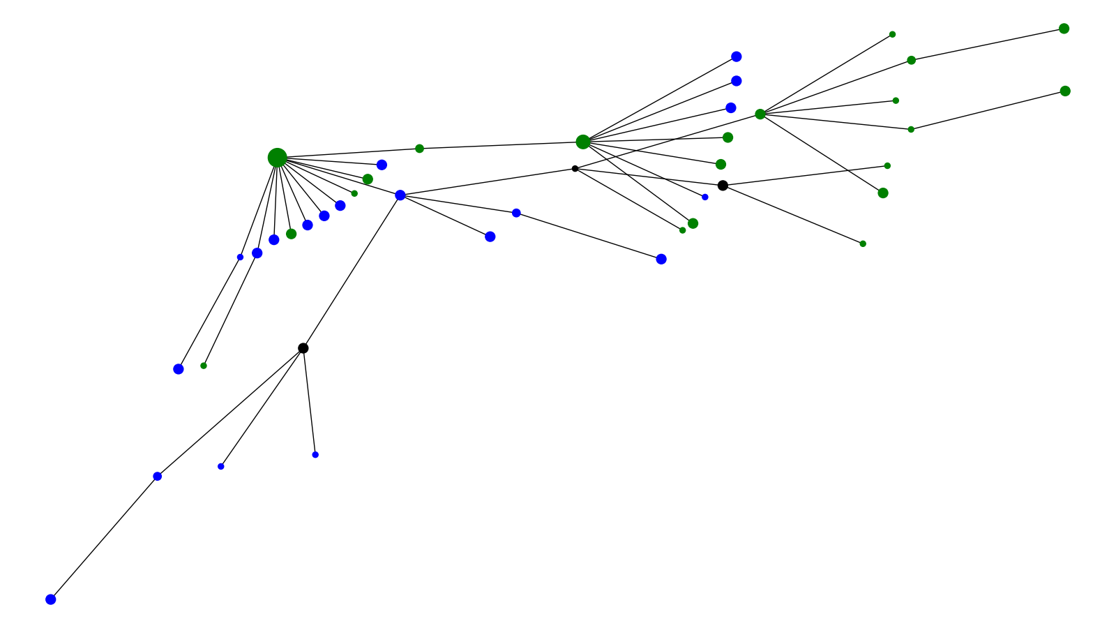
Outcome Cluster 6
Alive Unknown

Slide 30
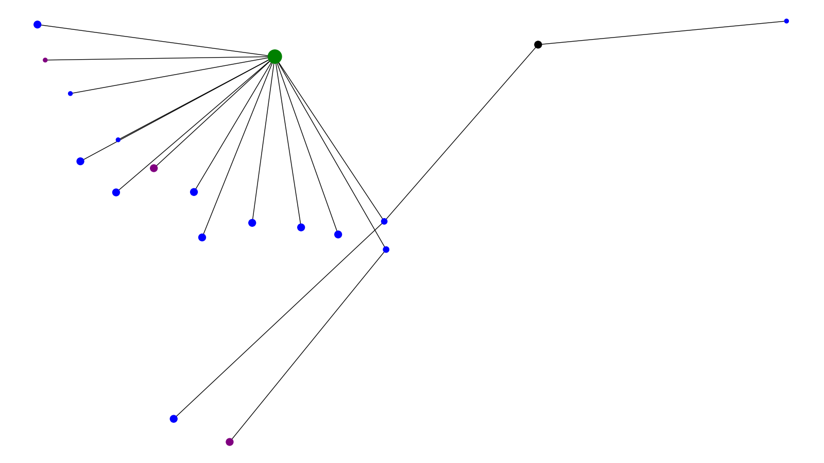
Outcome Cluster 7
Alive Deceased Unknown

Slide 31
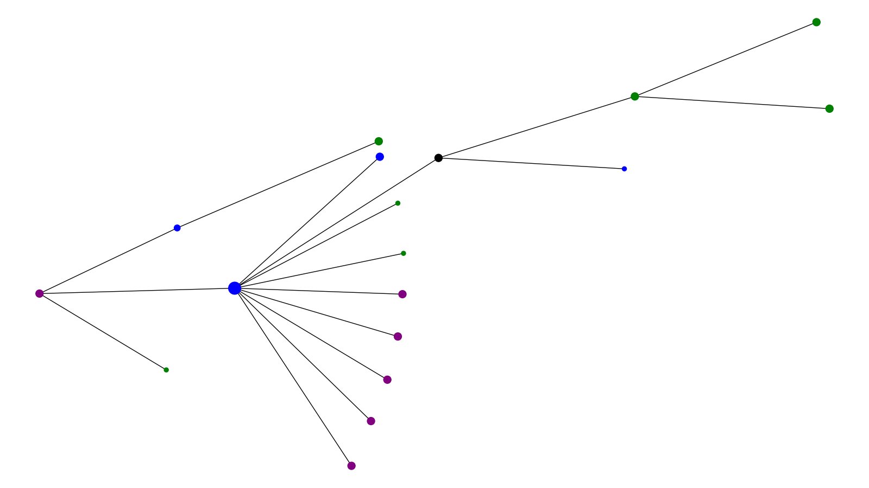
Outcome Cluster 8
Alive Deceased Unknown

Slide 32
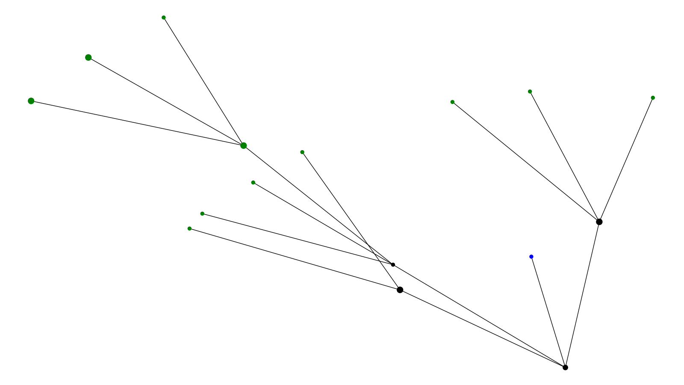
Outcome Cluster 9
Alive Unknown

Slide 33
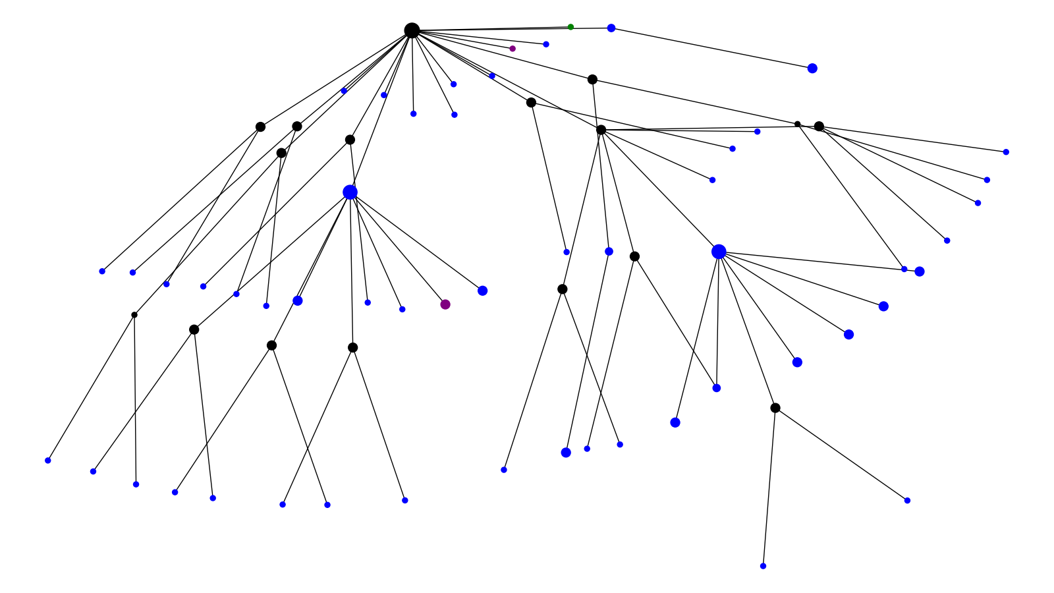
Outcome Cluster 10
Alive Deceased Unknown

Slide 34
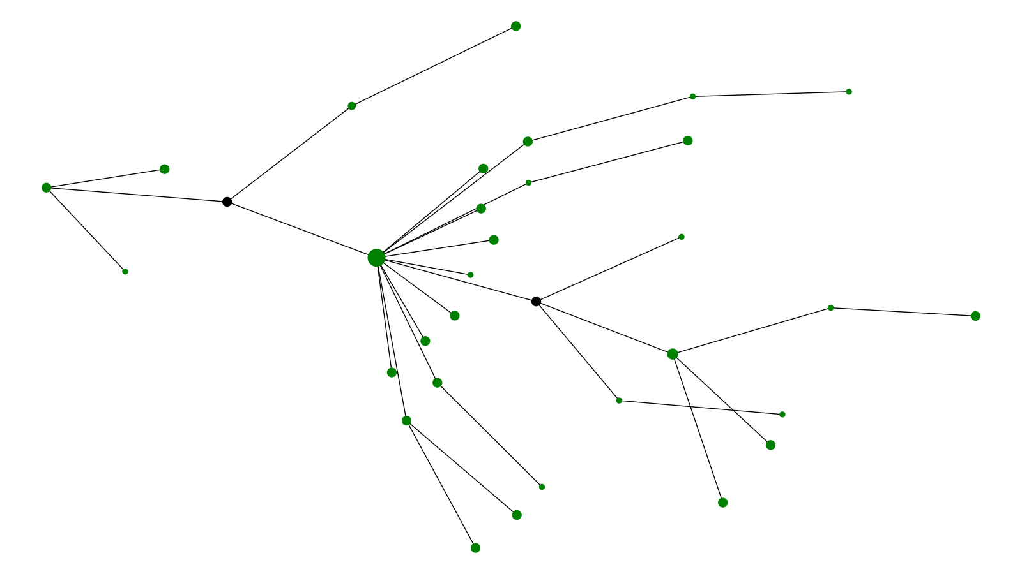
Outcome Cluster 11
Unknown

Slide 35
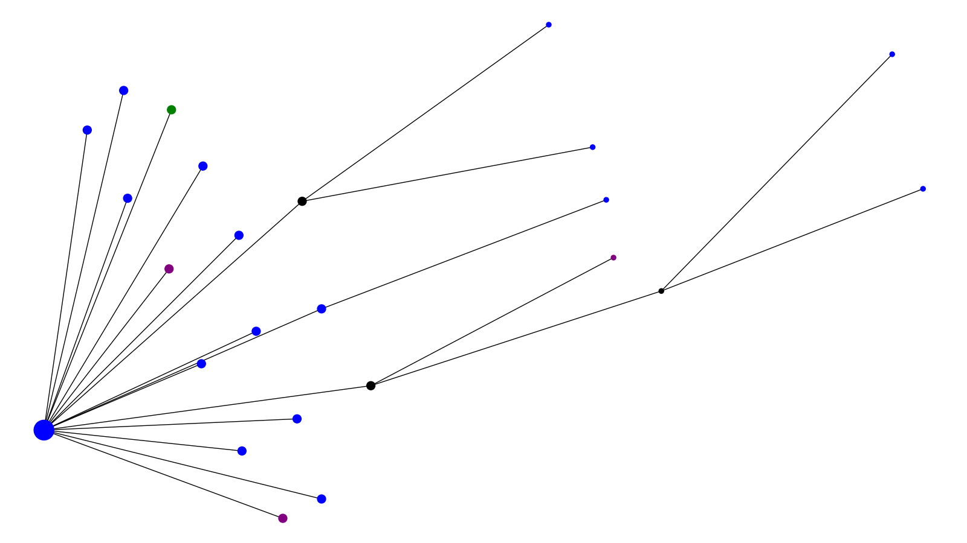
Outcome Cluster 12
Alive Deceased Unknown

Slide 36
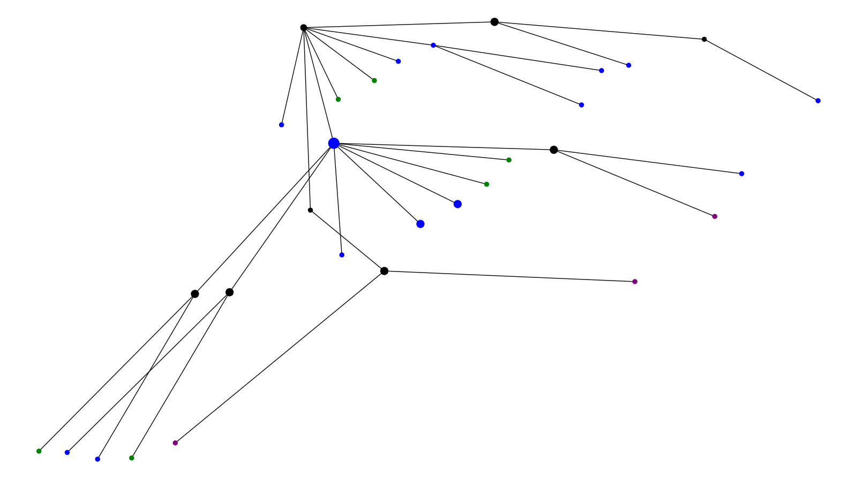
Outcome Cluster 13
Alive Deceased Unknown

Slide 37
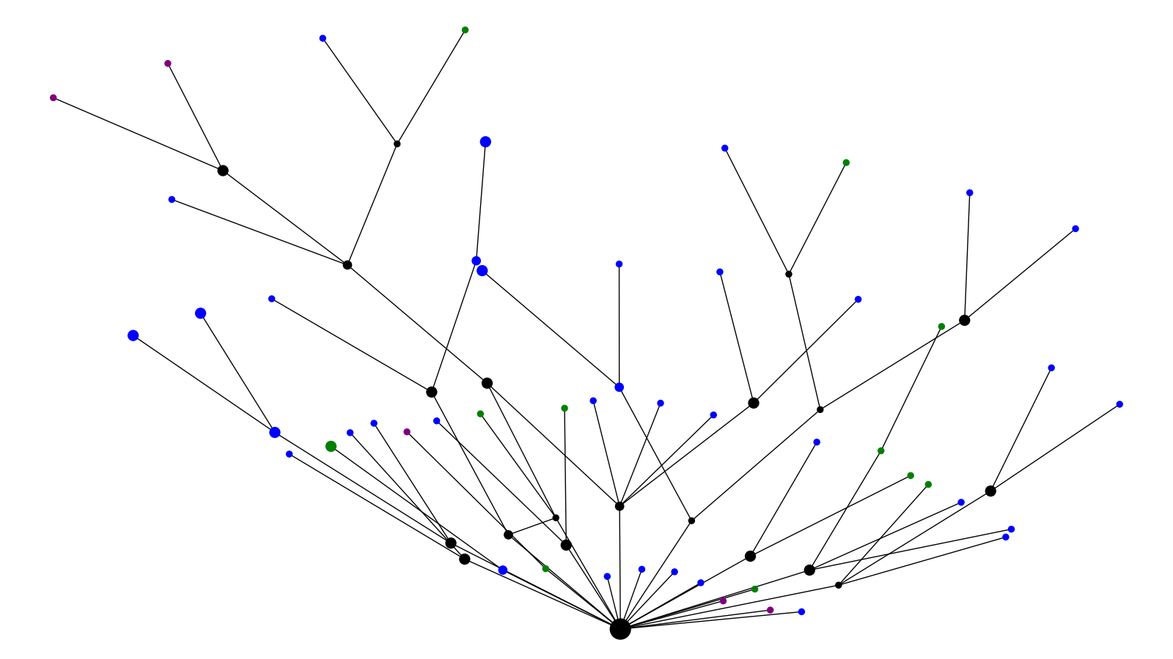
Outcome Cluster 14
Alive Deceased Unknown

Slide 38
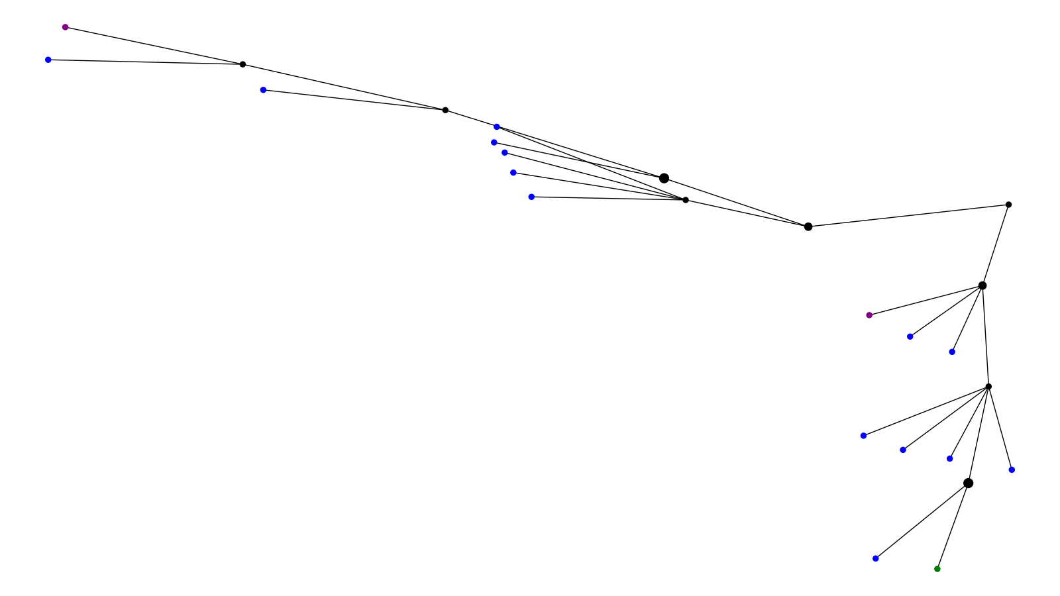
Outcome Cluster 15
Alive Deceased Unknown

Slide 39
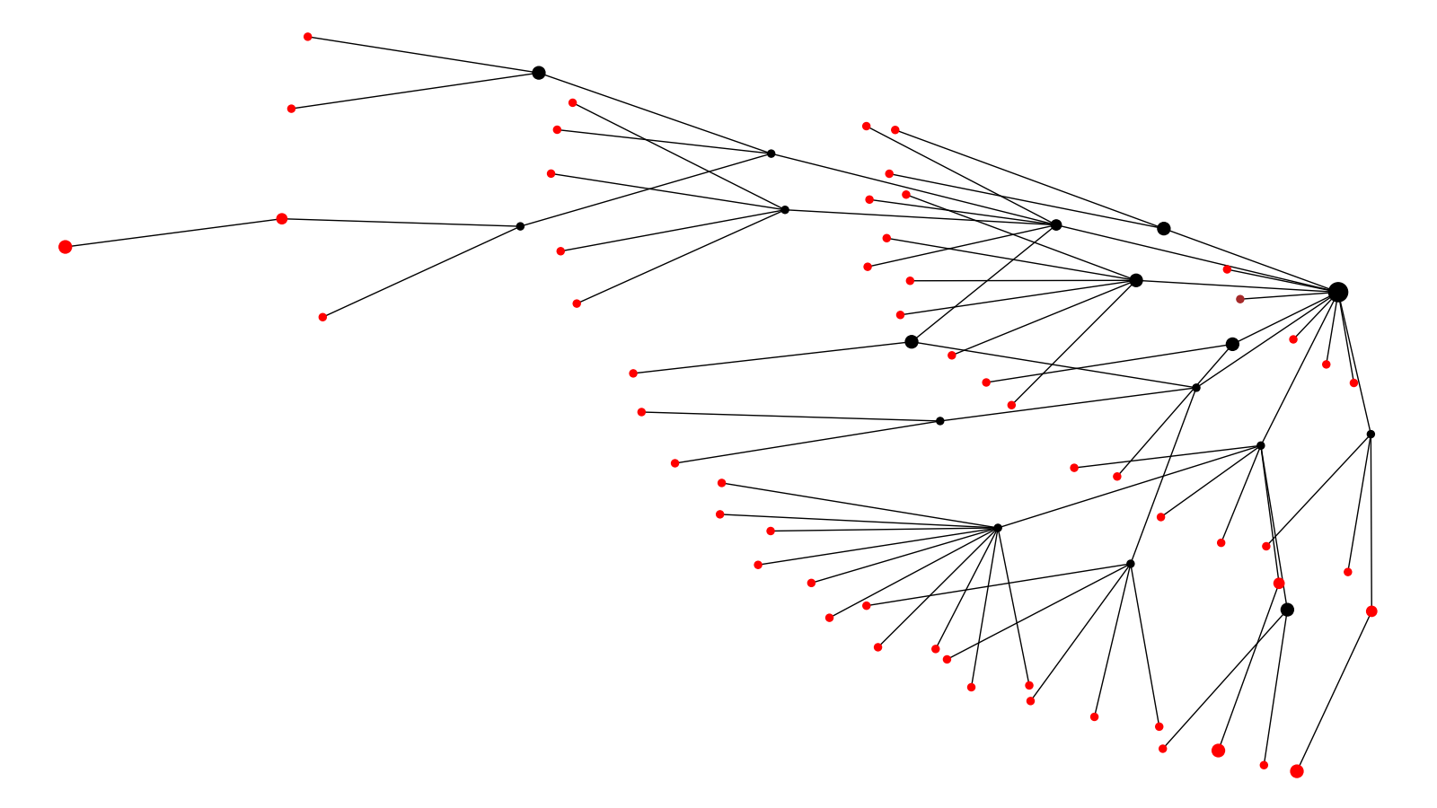
Location Cluster 1
California Texas

Slide 40
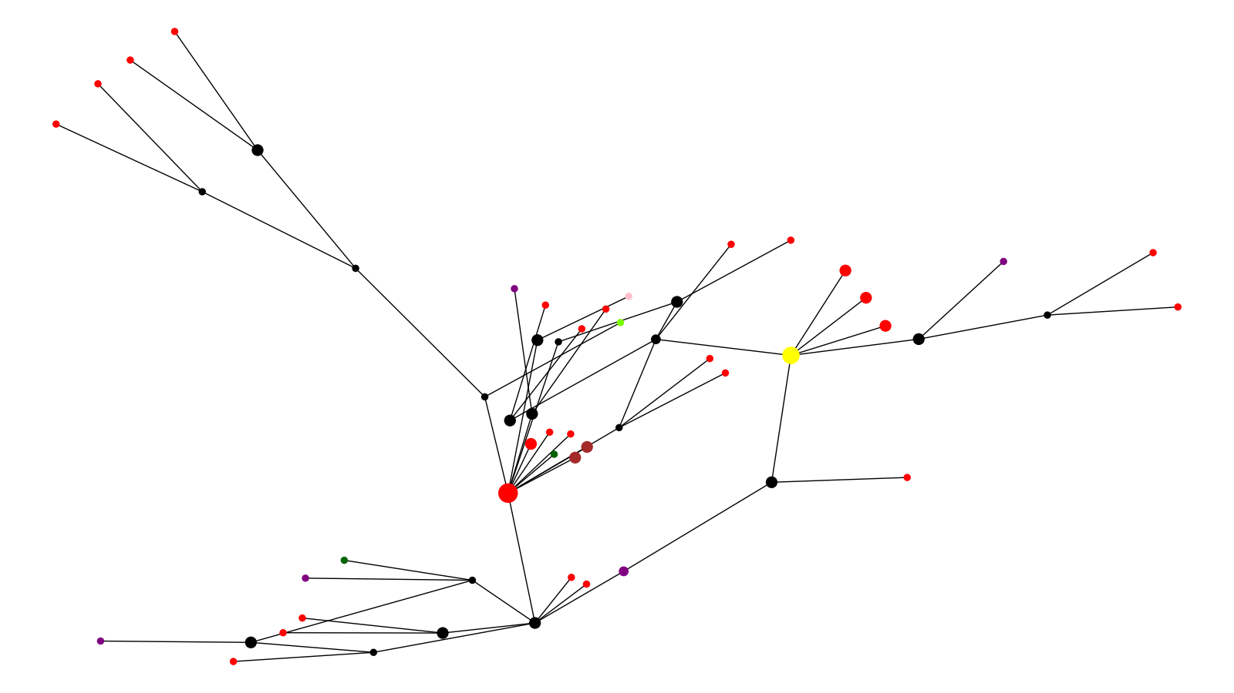
Location Cluster 2
California Montana New York Puerto Rico Texas Reference

Slide 41
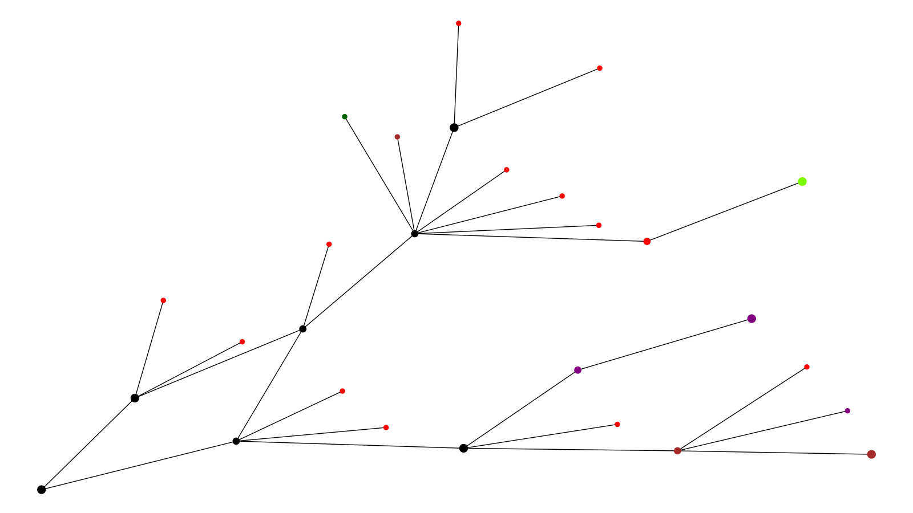
Location Cluster 3
California Montana New York Texas Other

Slide 42
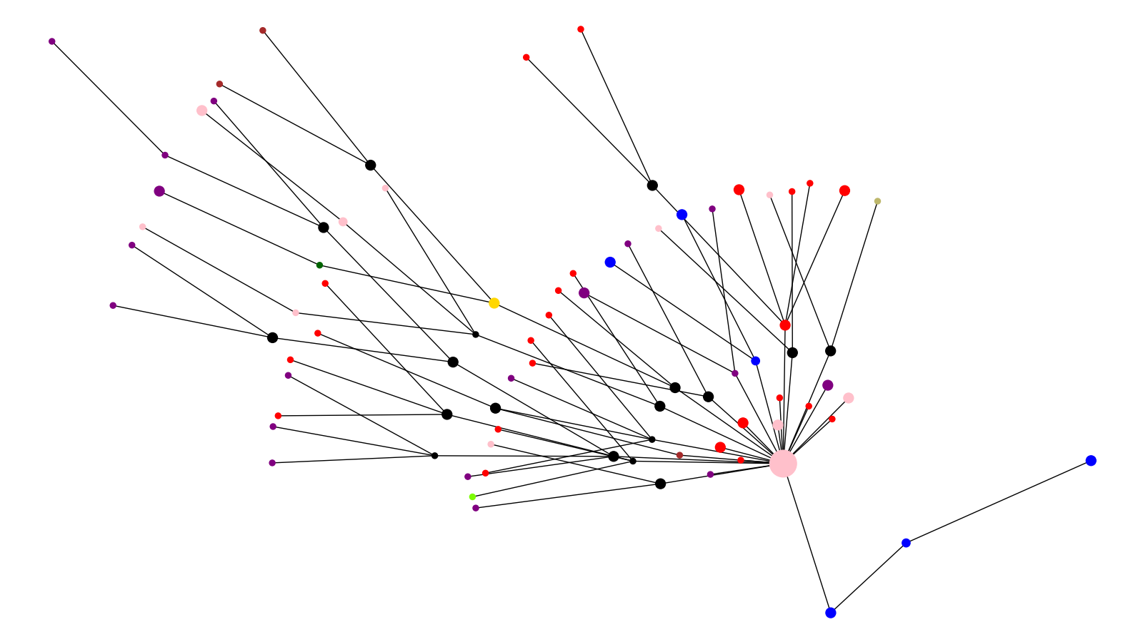
Location Cluster 4
California Montana New York Puerto Rico South Carolina Texas UK Reference Brazil Reference

Slide 43
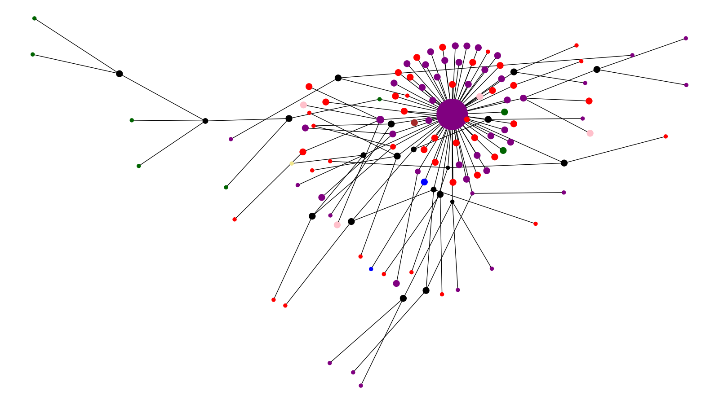
Location Cluster 5
California New York Puerto Rico South Carolina Other South Africa Ref

Slide 44
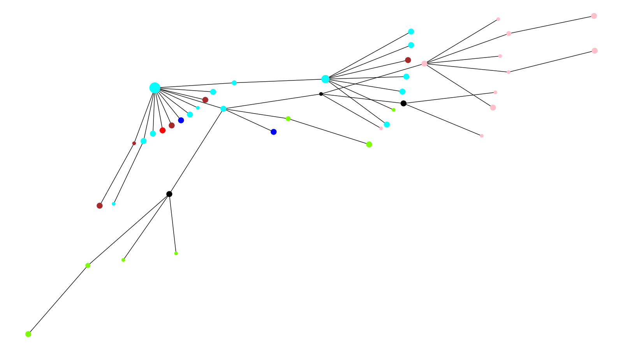
Location Cluster 6
California Montana Puerto Rico South Carolina Louisiana Texas

Slide 45
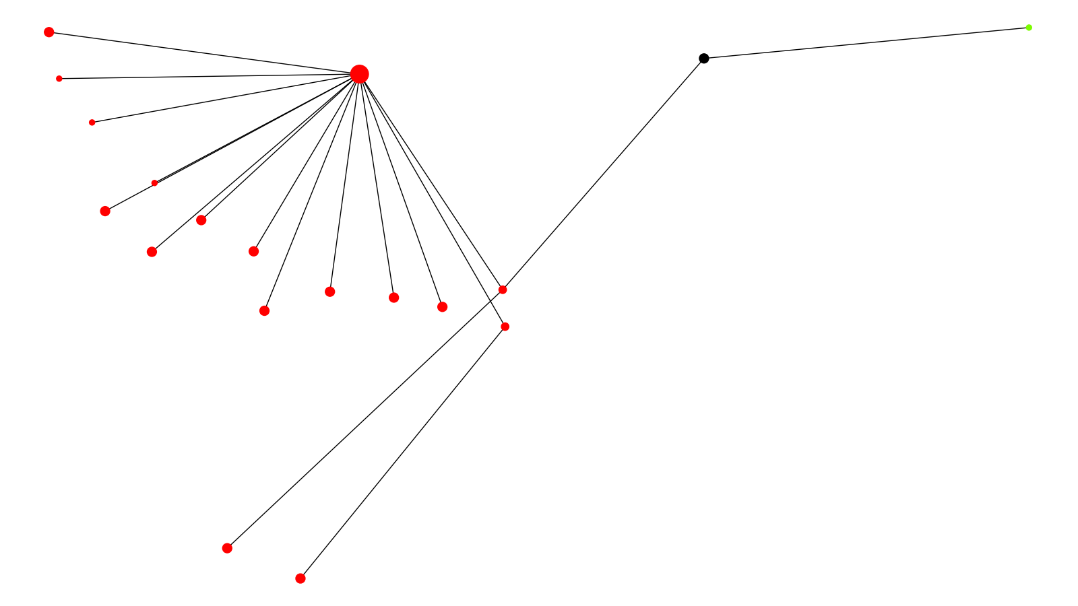
Location Cluster 7
California Montana

Slide 46
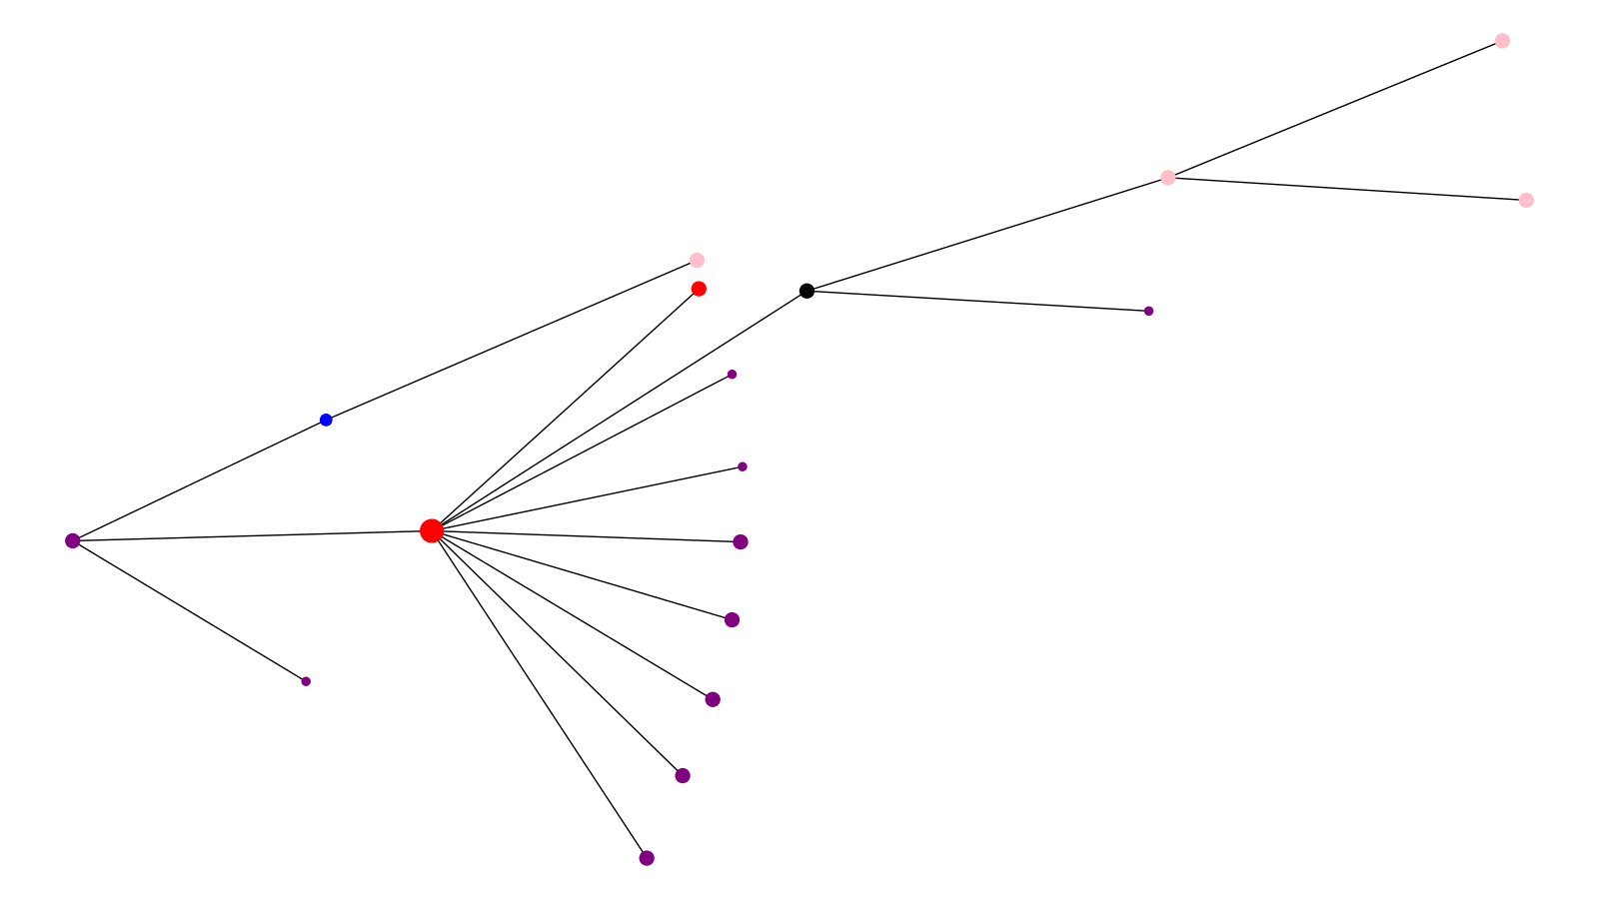
Location Cluster 8
California New York Puerto Rico South Carolina

Slide 47
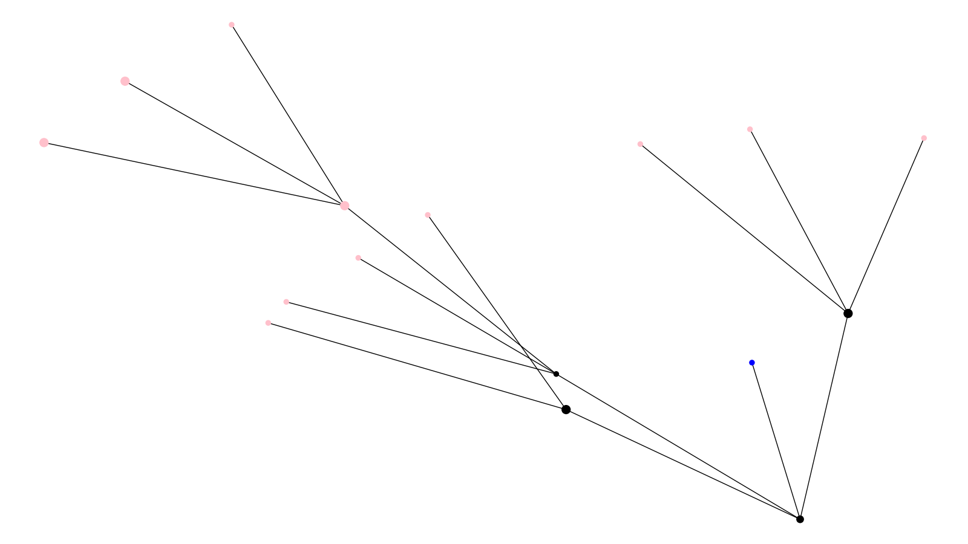
Location Cluster 9
Puerto Rico South Carolina

Slide 48
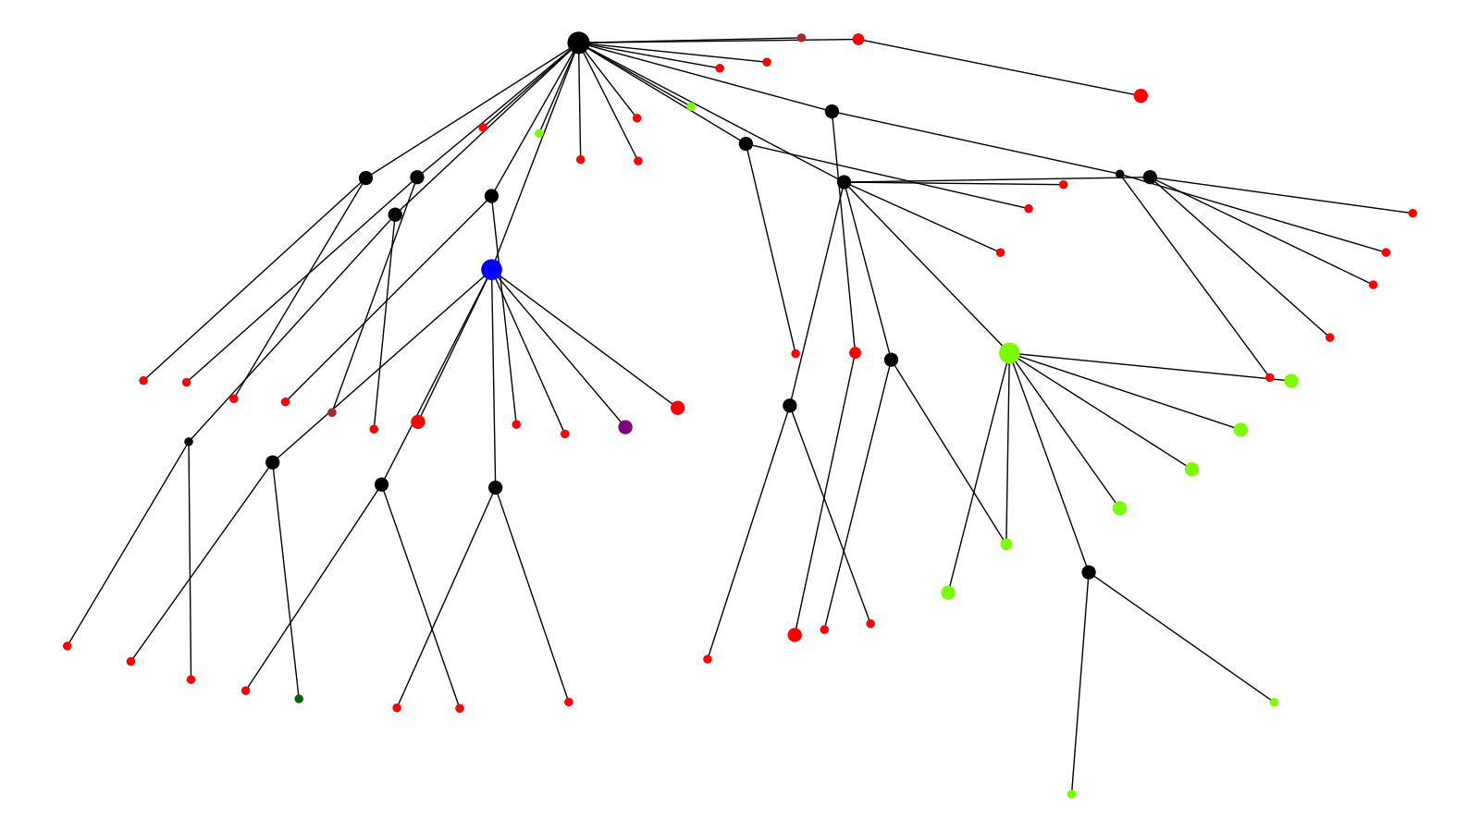
Location Cluster 10
California Montana New York South Carolina Texas

Slide 49
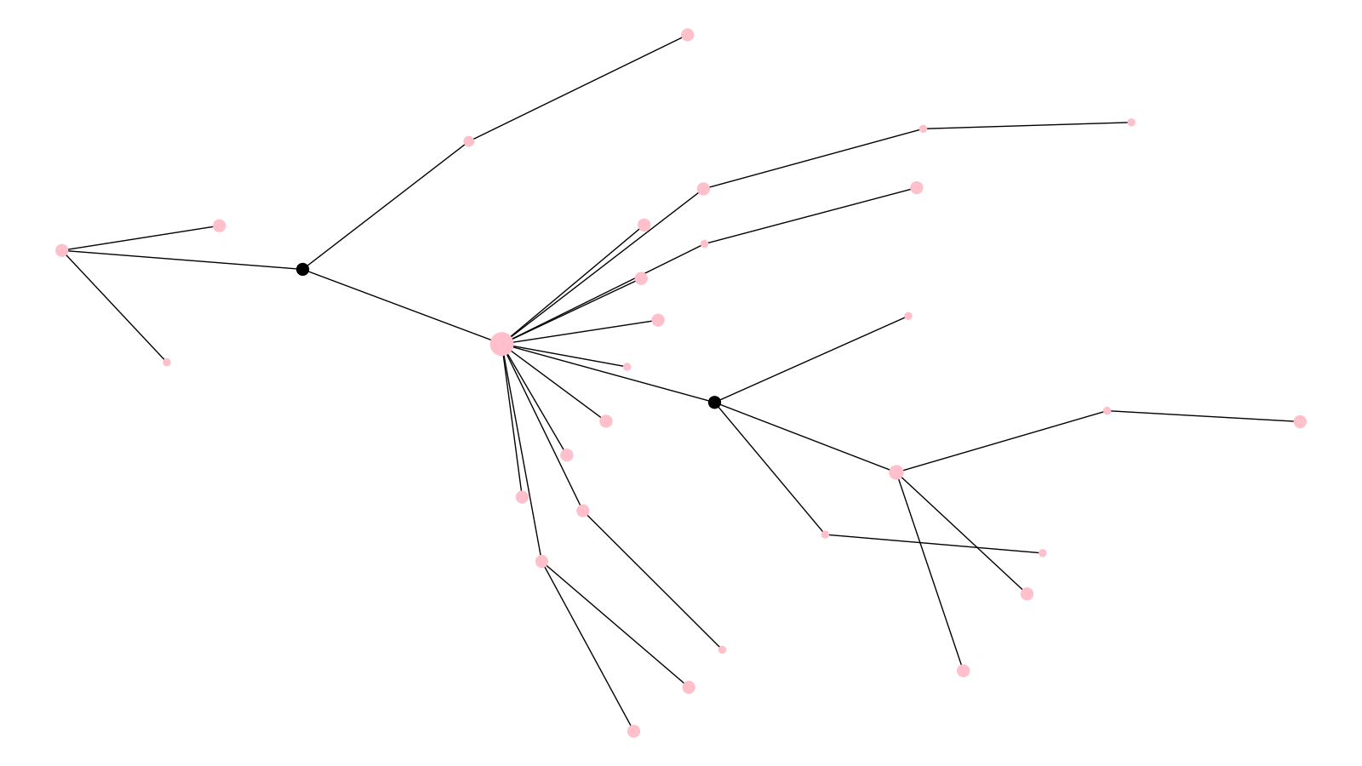
Location Cluster 11
Puerto Rico

Slide 50
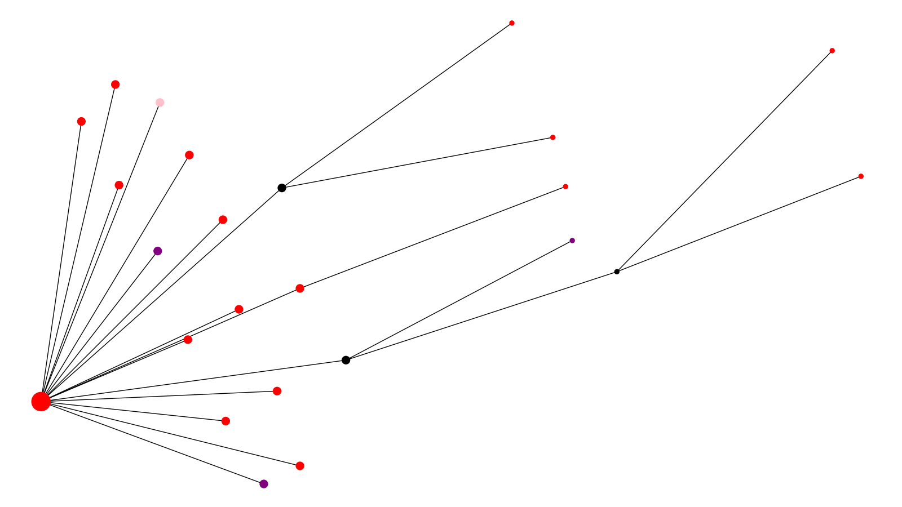
Location Cluster 12
California New York Puerto Rico

Slide 51

Location Cluster 13
California Montana Puerto Rico South Carolina Louisiana

Slide 52

Location Cluster 14
California Montana New York Puerto Rico Other

Slide 53

Location Cluster 15
California

Slide 54

Date Cluster 1
October / November 2020 December 2020 January / February 2021

Slide 55

Date Cluster 2
February / March 2020 April 2020 May / June 2020 July 2020 October / November 2020 December 2020 Reference

Slide 56

Date Cluster 3
February / March 2020 April 2020

Slide 57

Date Cluster 4
February / March 2020 April 2020 May / June 2020 July 2020 August / September 2020 October / November 2020 December 2020 January / February 2021 UK Reference Brazil Reference

Slide 58

Date Cluster 5
February / March 2020 April 2020 May / June 2020 July 2020 August / September 2020 December 2020 South Africa Ref

Slide 59

Date Cluster 6
February / March 2020 April 2020 May / June 2020 July 2020 August / September 2020 October / November 2020

Slide 60

Date Cluster 7
February / March 2020 April 2020

Slide 61

Date Cluster 8
February / March 2020 April 2020 May / June 2020 August / September 2020 October / November 2020

Slide 62

Date Cluster 9
July 2020 August / September 2020

Slide 63

Date Cluster 10
May / June 2020 July 2020 October / November 2020 December 2020

Slide 64

Date Cluster 11
July 2020 August / September 2020 October / November 2020

Slide 65

Date Cluster 12
February / March 2020 April 2020 July 2020 December 2020 January / February 2021

Slide 66

Date Cluster 13
April 2020 May / June 2020 July 2020 January / February 2021

Slide 67

Date Cluster 14
May / June 2020 July 2020 August / September 2020 October / November 2020 December 2020 January / February 2021

Slide 68

Date Cluster 15
December 2020

Slide 69

Accession ID Cluster 1

Slide 70

Accession ID Cluster 2

Slide 71

Accession ID Cluster 3

Slide 72

Accession ID Cluster 4

Slide 73

Accession ID Cluster 5

Slide 74

Accession ID Cluster 6

Slide 75

Accession ID Cluster 7

Slide 76

Accession ID Cluster 8

Slide 77

Accession ID Cluster 9

Slide 78

Accession ID Cluster 10

Slide 79

Accession ID Cluster 11

Slide 80

Accession ID Cluster 12

Slide 81

Accession ID Cluster 13

Slide 82

Accession ID Cluster 14

Slide 83

Accession ID Cluster 15

